Slide 1


Nau mai (welcome) to the ‘What on Earth is Design’ drop-in: Designing for neurodiversity part 3, dyscalculia
Hosted by the Designers
in the Food Risk Management Regulation team
Notes:
Welcome to the what on earth is design dropin space
These meetings are an informal channel for the Food Regulation designers to share our knowledge, skills and the work we have done in Food Reg and across NZFS. We believe in sharing what we know to empower you to enhance the work you do and provide you with new learnings or practical things you can apply to your work
*Disclaimer – I am still learning and aiming for progress, not perfection.
The content contains my own opinions not those of MPI
This is based on my own experience and reading on this topic area
_____________________________________________________________________________________________________________

Slide 2
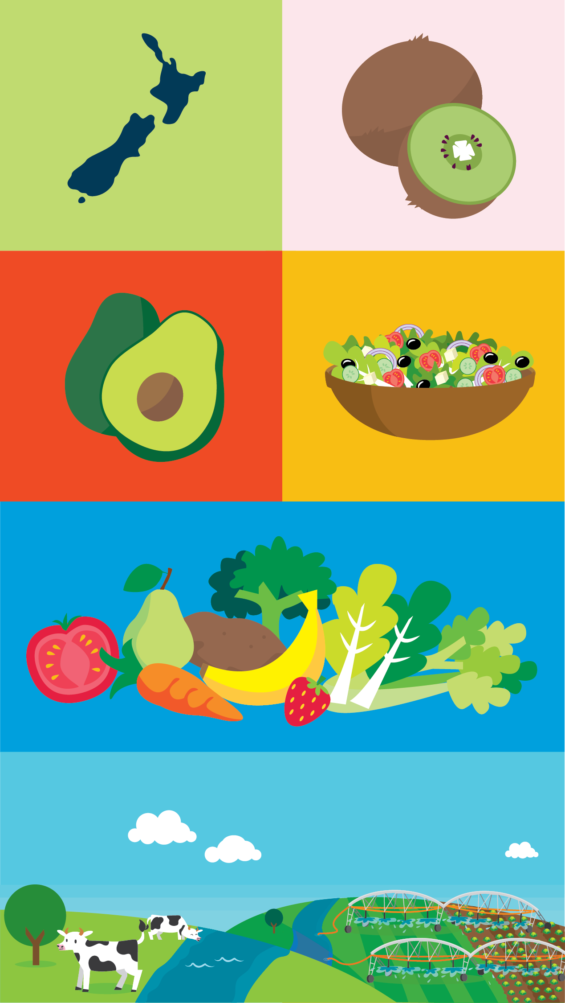
Agenda
About me
What is design?
What has been designed by Food Risk Management?
What does neurodivergent mean?
How can you help?
Feedback & resources

Slide 3

My name is Krystle Chester and I am a neurodivergent service designer
My role is to:
Advocating for users
Understanding user needs through research
Involving users in the design process as much as possible!
Testing materials and services with users
Promoting inclusive design

Slide 4
What is design?
“Design is a discipline of study and practice focused on the interaction between a person — a ‘user’— and the man-made environment, taking into account aesthetic, functional, contextual, cultural and societal considerations.”
Notes:
Ref
https://www.theicod.org/en/professional-design/what-is-design/what-is-design

Slide 5
What is design?
“The basic definition of the word ‘design’ is simply to plan something in advance.”
Notes:
https://www.interaction-design.org/literature/article/what-is-design

Slide 6
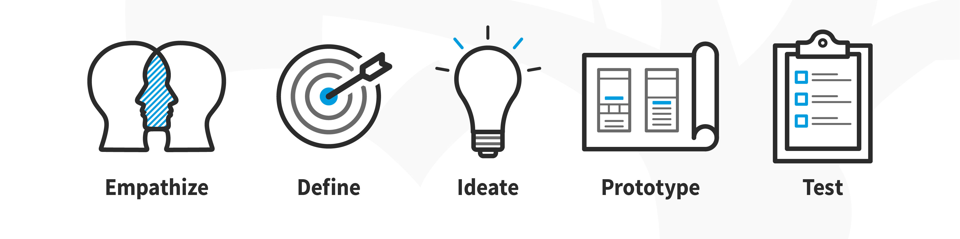
What is design?
“The basic definition of the word ‘design’ is simply to plan something in advance.”
Notes:
Ref
https://www.interaction-design.org/literature/article/what-is-design
Image source
https://www.interaction-design.org/literature/article/what-is-design-thinking-and-why-is-it- so-popular

Slide 7
Design components and considerations
Content – what is said and how it is said
Visual communication – how it looks, how things are communicated without words, colour, images, icons, graphs, infographics
Lay out / structure – use of space, headings, lists, order
Format – video, audio, print, web, PDF, Word
Typography – font style, font size, spacing between characters, character size, character differentiation
Findability/searchability – use of key words, web placement, distribution of product

Slide 8

Design is part of everyone’s job
Notes:
Stock image

Slide 9
What have we designed at Food Safety?
Videos, posters, booklets, web pages to explain food safety rules to businesses
Support and education for verifiers and RAs – for example, Food Safety Academy, other guidance and training materials
Processes – remote verifications, remote checks, school kitchen verifications, verifier recognition and professional development

Slide 10
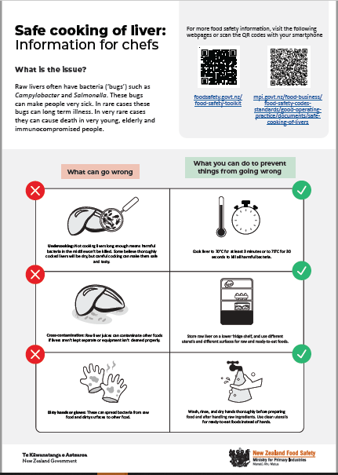

Cooking livers safely

Slide 11

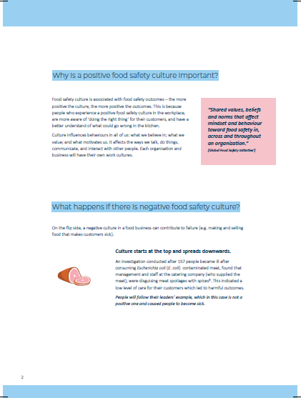
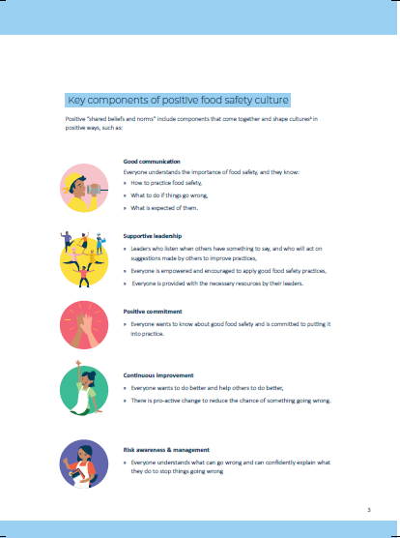
Kitchen culture guidance

Slide 12
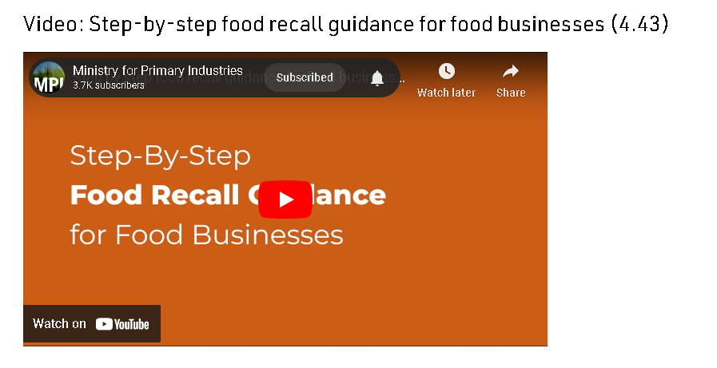
Recall guidance video
Notes:
https://youtu.be/RZLSkWB5Lxk?si=ApS2VSmloWSpYvxp

Slide 13

What does neurodivergent mean?
“Neurodivergent is a nonmedical term that describes people whose brains develop or work differently for some reason. This means the person has different strengths and struggles from people whose brains develop or work more typically.”
Notes:
Ref
https://my.clevelandclinic.org/health/symptoms/23154-neurodivergent

Slide 14
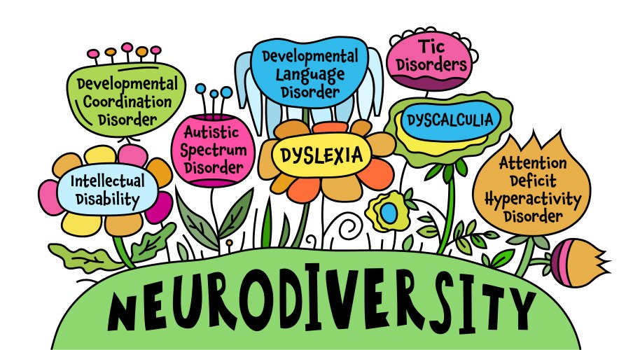
Types of neurodivergent conditions
ADHD
Austism Spectrum Disorder
Dyslexia
Dyscalculia
Dyspraxia
Dysgraphia
Notes:
Ref
https://my.clevelandclinic.org/health/symptoms/23154-neurodivergent
Stock image

Slide 15
Today I will focus on dyscalculia

Slide 16
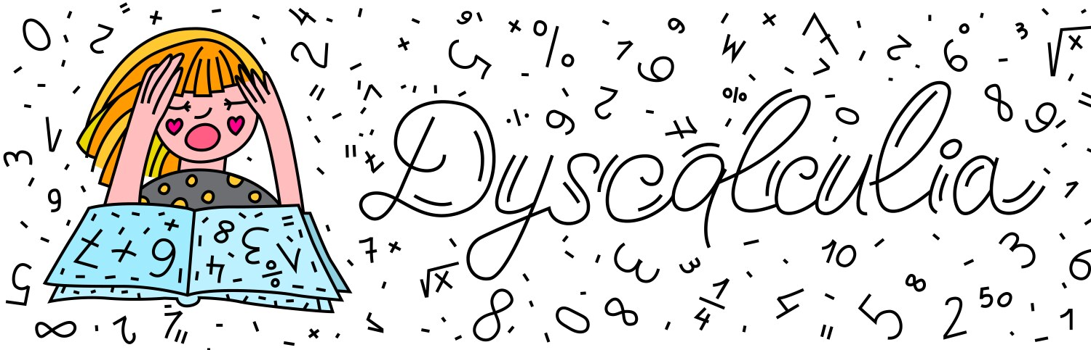
What is dyscalculia?
This learning disorder affects a person’s ability to do mathematics
Notes:
From https://my.clevelandclinic.org/health/diseases/23949-dyscalculia
Stock image

Slide 17
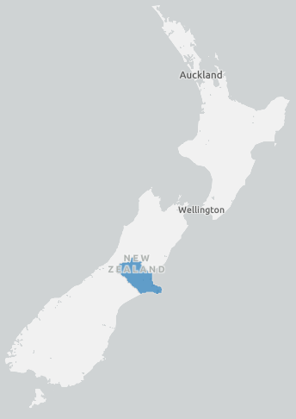
About 6 in 100 people have dyscalculia
That’s about 300,000 in NZ
Approximately the population of Christchurch
Notes:
Reference
https://my.clevelandclinic.org/health/diseases/23949-dyscalculia
Image source
https://opendata.canterburymaps.govt.nz/

Slide 18
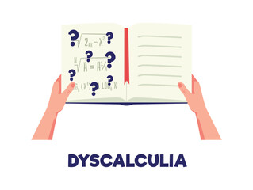
What is dyscalculia?
Difficulty reading, understanding and working with numbers.
It impacts the ability to handle money, telling the time, time management, estimating how long things take, understanding percentages, and remembering number facts
It affects working memory (that is, memory used in the moment)
Notes:
References
https://accessiblenumbers.com/about-dyscalculia-low-numeracy-and-maths-anxiety
https://designnotes.blog.gov.uk/2022/11/28/designing-for-people-with-dyscalculia-and-low-numeracy/
https://my.clevelandclinic.org/health/diseases/23949-dyscalculia
https://accessiblenumbers.com/about-dyscalculia-low-numeracy-and-maths-anxiety

Slide 19
What is dyscalculia?
People with dyscalculia may struggle with:
  counting backwards
  recognising patterns
  sorting out directions like left, right, high, low and depth
  understanding quantities
  telling the time
  identifying large or small numbers in a list
  making sense of money and estimating quantities
  visual and spatial orientation
Notes:
References
https://designnotes.blog.gov.uk/2022/11/28/designing-for-people-with-dyscalculia-and-low-numeracy/
https://accessiblenumbers.com/about-dyscalculia-low-numeracy-and-maths-anxiety
https://my.clevelandclinic.org/health/diseases/23949-dyscalculia

Slide 20



Choose a typeface characters look distinct
v
“1" and "I" ,"0 and "O“ “L and 7”, “2” and “5” can look the same depending on the typeface
People with dyscalculia can get these numbers and letters mixed up
Notes:
Image source
https://business.scope.org.uk/article/font-accessibility-and-readability-the-basics
References
https://accessiblenumbers.com/
https://readabilityguidelines.co.uk/grammar-points/numbers/
https://business.scope.org.uk/article/font-accessibility-and-readability-the-basics

Slide 21
Leave space around numbers
Leaving space around numbers helps people easily pick out the shape of numbers
This makes reading quicker and easier
v
1 2 3 4 5 6 7 8 9 0
Notes:
Image
By Krystle
References
https://accessiblenumbers.com/
https://readabilityguidelines.co.uk/grammar-points/numbers/

Slide 22
Round up numbers and remove unnecessary content
Avoid using decimals and round numbers up or down
For example, $100 and $100.00 is the same amount. But for people with dyscalculia, the amount may look like $1000 (one thousand). Its ok if you must display exact amounts of money, like $7.56.
If using large numbers, like millions, write the number in words, like 6 million, not $6,000,000.
v
$100.00
$100
v
$6,000,000
$6 million
Notes:
Image
By Krystle
References
https://accessiblenumbers.com/
https://designnotes.blog.gov.uk/2022/11/28/designing-for-people-with-dyscalculia-and-low-numeracy/ (for poster)
https://readabilityguidelines.co.uk/grammar-points/numbers/

Slide 23
About 1 in 5 NZ adults have low numeracy. In the UK 1 in 5 adults don’t know how to do fractions or percentages.
Fractions are especially difficult for people with dyscalculia
Instead of using percentages or fractions, try to use statements like 1 in 7 people instead of 14.4% of people or 1/7 of people.
Avoid fractions, percentages and decimals
v
1 in 7
14.3%
1/7
Notes:
Image
By Krystle
References
https://accessiblenumbers.com/
https://readabilityguidelines.co.uk/grammar-points/numbers/
An-empirical-portrait-of-New-Zealand-adults-living-with-low-literacy-and-numeracy-skills_report.pdf (aut.ac.nz)
https://designnotes.blog.gov.uk/2022/11/28/designing-for-people-with-dyscalculia-and-low-numeracy/ (for poster)

Slide 24
Explain what numbers mean
1 in 5 adults in NZ have a low level of numeracy proficiency
making sense of data is stressful and not everyone knows how to interpret data, particularly people with dyscalculia
When your content includes a chart or graph , describe it in the body text. The descriptions should be equally as informative as viewing the chart.
The title should describe the main trend you want to the reader to be aware of. They are much more likely to understand and remember the main trend when its in the title.
Notes:
Quotes from (in order)
An-empirical-portrait-of-New-Zealand-adults-living-with-low-literacy-and-numeracy-skills_report.pdf (aut.ac.nz)
https://designnotes.blog.gov.uk/2022/11/28/designing-for-people-with-dyscalculia-and-low-numeracy/ (for poster)
https://accessiblenumbers.com/
https://accessibility.blog.gov.uk/2023/04/13/text-descriptions-for-data-visualisations/
https://service-manual.ons.gov.uk/data-visualisation/guidance/chart-text
Other refs
https://service-manual.ons.gov.uk/content/content-types/datasets
Tips from https://www.vizzu.io/blog/data-visualization-examples
1. Clarity is Key
The purpose of a data visualization is to tell a data story. Most people don’t want to hear a complicated story that’s difficult to understand. Ideally, the viewer should be able to grasp the message behind the data at first glance.
Choose simple charts: You don’t need to use a highly innovative chart. Bar charts, line graphs...the classics are powerful for a reason! Emphasize the key points using color, size, and strategic annotations and headings.
Tell a story: Even a simple chart benefits from a clear title and context. To make things even more engaging, use interactive features such as animation.
4. Relevance and Focus
Your audience matters. You might not show the same data visualization to a group of data scientists as you would to the general public, for instance. Make sure you spend some time working out what the average viewer’s knowledge level is and what you want them to take away from the data visualization.
Define your goals: Are you exploring trends? Highlighting comparisons? Nailing this down will make your visualization choices much easier.
Add titles and annotations: Improve clarity with a few well-chosen words to explain things in a way that’s appropriate for the audience.

Slide 25
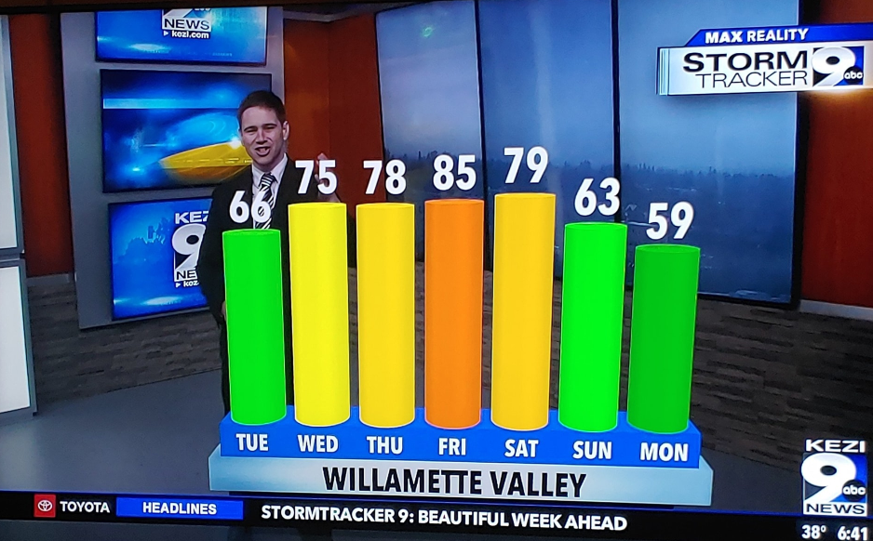
Bad examples of graphs
Figure 1
Doesn’t tell us what the numbers mean. There’s no title or labels
Notes:
Figure 1
https://www.codeconquest.com/blog/12-bad-data-visualization-examples-explained/
Poor example as it doesn’t tell us what the numbers mean. There’s no title and no labels, no caption.
“What Does This Graph Show?
Consider the following bar graph broadcasted in a news show.
What Does This Graph Show?
In the above image, the host probably shows the forecast of temperatures for each day of the week in Fahrenheit. However, there is no context about what the host is trying to convey. If a person looks at this visualization, they will never be able to identify if this graph represents temperature or wind speed or the number of accidents, or anything else. Hence, This visualization is hiding the relevant data.”
Figure 2
https://analythical.com/blog/examples-of-awful-data-visualization
There’s more detail on this one yet it doesn’t add much.
“The first problem is that they’ve presented a volume metric (Total Users) as a ratio metric (i.e. 99.48%), and it’s unclear to me as to what the data is showing here. Is this the % of total users who access each app on an Android device? If so, the only interpretation I can derive from this is that 99.48% of users of the YouTube mobile app in the USA are using an Android smartphone. But intuitively, this can’t be true. I mean, surely more than 0.52% of YouTube app users in the U.S. are on iOS. Apple has a marketshare of roughly 43.6% in the U.S. and YouTube mobile is a popular app, so this just doesn’t seem possible. Which means that a) their data is wrong, b) they have twisted the interpretation of this so far it’s impossible to read, or c) I’m completely misreading this. But with this statement – “According to data for the USA from SimilarWeb, the share of total Android users was” – I’m just not sure how else this graphic can be read.
But the confusion doesn’t end there. The inner circle, which shows the % of active users, is also hugely problematic. My first question is, are active users a subset of total users? It seems logical that this should be true, and if so they’ve actually misinterpreted the data (e.g. that Twitter, Pinterest and LinkedIn have more active audiences). This graphic actually shows that YouTube and Facebook have the highest levels of activity, and I think what they’ve done is incorrectly conclude that the level of active users for Twitter, Pinterest and LinkedIn relative to the % of total users means that they have higher rates of activity, which is totally wrong. Either way, this graphic is poorly constructed and unnecessarily confusing. You shouldn't have to think this much to consume and interpret the meaning of an infographic.
What should they have done?
Honestly, I don’t know where to begin. My first suggestion would be to never create a pie chart within pie chart, or any other chart type for that matter. Beyond that, there are tons of other issues with the data they’ve used and how they have presented it (e.g. volume vs ratio metrics). Simply removing the pie within a pie isn’t going to solve this, so my suggestion would be to scrap this graphic completely and start over.”

Slide 26
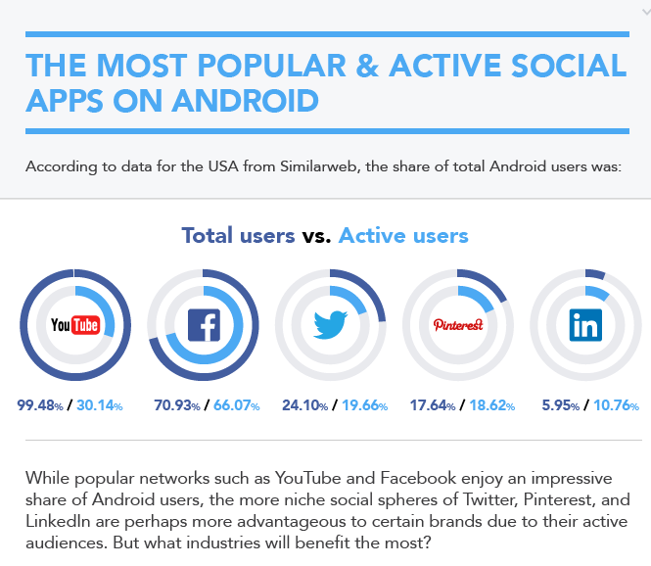
Bad examples of graphs
Figure 2
There’s a lot of text but it doesn’t really tell us anything
Notes:
Figure 1
https://www.codeconquest.com/blog/12-bad-data-visualization-examples-explained/
Poor example as it doesn’t tell us what the numbers mean. There’s no title and no labels, no caption.
“What Does This Graph Show?
Consider the following bar graph broadcasted in a news show.
What Does This Graph Show?
In the above image, the host probably shows the forecast of temperatures for each day of the week in Fahrenheit. However, there is no context about what the host is trying to convey. If a person looks at this visualization, they will never be able to identify if this graph represents temperature or wind speed or the number of accidents, or anything else. Hence, This visualization is hiding the relevant data.”
Figure 2
https://analythical.com/blog/examples-of-awful-data-visualization
There’s more detail on this one yet it doesn’t add much.
“The first problem is that they’ve presented a volume metric (Total Users) as a ratio metric (i.e. 99.48%), and it’s unclear to me as to what the data is showing here. Is this the % of total users who access each app on an Android device? If so, the only interpretation I can derive from this is that 99.48% of users of the YouTube mobile app in the USA are using an Android smartphone. But intuitively, this can’t be true. I mean, surely more than 0.52% of YouTube app users in the U.S. are on iOS. Apple has a marketshare of roughly 43.6% in the U.S. and YouTube mobile is a popular app, so this just doesn’t seem possible. Which means that a) their data is wrong, b) they have twisted the interpretation of this so far it’s impossible to read, or c) I’m completely misreading this. But with this statement – “According to data for the USA from SimilarWeb, the share of total Android users was” – I’m just not sure how else this graphic can be read.
But the confusion doesn’t end there. The inner circle, which shows the % of active users, is also hugely problematic. My first question is, are active users a subset of total users? It seems logical that this should be true, and if so they’ve actually misinterpreted the data (e.g. that Twitter, Pinterest and LinkedIn have more active audiences). This graphic actually shows that YouTube and Facebook have the highest levels of activity, and I think what they’ve done is incorrectly conclude that the level of active users for Twitter, Pinterest and LinkedIn relative to the % of total users means that they have higher rates of activity, which is totally wrong. Either way, this graphic is poorly constructed and unnecessarily confusing. You shouldn't have to think this much to consume and interpret the meaning of an infographic.
What should they have done?
Honestly, I don’t know where to begin. My first suggestion would be to never create a pie chart within pie chart, or any other chart type for that matter. Beyond that, there are tons of other issues with the data they’ve used and how they have presented it (e.g. volume vs ratio metrics). Simply removing the pie within a pie isn’t going to solve this, so my suggestion would be to scrap this graphic completely and start over.”

Slide 27

Do user research
Involve people who struggle with numbers in the design process
You can include them by:
testing your content to make sure it’s clear
Doing user interviews to understand their needs and problems using a product/service
Notes:
Image
Stock image
References
https://accessiblenumbers.com/
https://designnotes.blog.gov.uk/2022/11/28/designing-for-people-with-dyscalculia-and-low-numeracy/ (for poster)
https://www.stylemanual.gov.au/writing-and-designing-content/user-research-and-content

Slide 28

What’s next?
Why you should include users/customers in your projects and how to include them
10 October 2024
Sharing user research insights over the years
7 November 2024
Notes:
Subject to change

Slide 29
How did you feel about this talk?
Use react buttons to show how you feel
Do you have any feedback for me? What can be improved? What should we continue?
What else do you want to hear about?
Any guest speakers you want to hear from? Would you like to present on a topic?
Notes:
Use react buttons to show how you feel
Do you have any feedback for me? What can be improved? What should we continue?
What else do you want to hear about?
Any guest speakers you want to hear from?

Slide 30
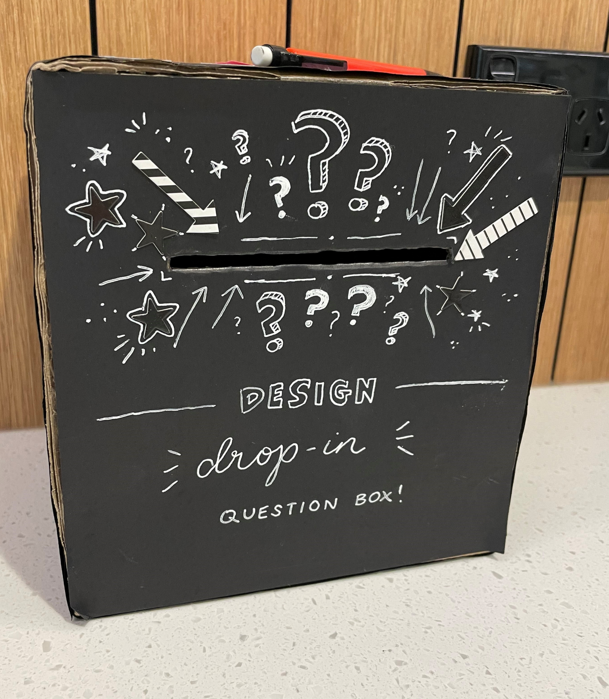
Feedback
Email DL_NZFS_Design DL_NZFS_Design@mpi.govt.nz
Or put your feedback into this box by the coffee machine on level 8 of Pastoral House

Slide 31

Want to hear more?
Join our distribution list by going to https://selfserviceportal.intranet.mpi.govt.nz/DistributionLists and searching by DL Design Drop In
Find us on Viva Engage by searching for MPI_Design Drop Ins_Team
Email us at DL_NZFS_Design DL_NZFS_Design@mpi.govt.nz
Notes:
Image by Alesha Garton

Slide 32

Thank you for coming along!
Any pātai (questions)? ☺
Notes:
Image by Alesha Garton
Thank you for coming along!
Any pātai (questions)? ☺

Slide 33
Resources
About dyscalculia
https://accessiblenumbers.com/about-dyscalculia-low-numeracy-and-maths-anxiety
https://my.clevelandclinic.org/health/diseases/23949-dyscalculia
General accessibility guidance
https://accessibility.blog.gov.uk/2016/09/02/dos-and-donts-on-designing-for-accessibility/
Neurodiversity design guidance
https://www.neurodiversity.design/

Slide 34
Resources
Dyscalculia and numeracy related design guidance
https://readabilityguidelines.co.uk/grammar-points/numbers/
https://designnotes.blog.gov.uk/2022/11/28/designing-for-people-with-dyscalculia-and-low-numeracy/
https://www.digital.govt.nz/standards-and-guidance/design-and-ux/content-design-guidance/numbers/
https://www.stylemanual.gov.au/grammar-punctuation-and-conventions/numbers-and-measurements

