Slide 1
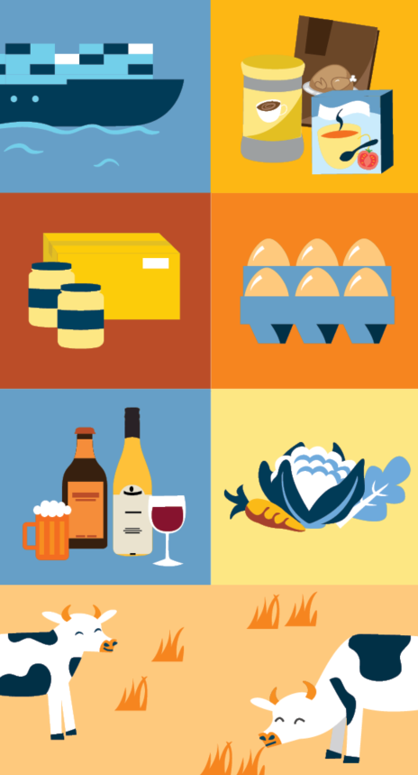

Nau mai (welcome) to the ‘What on Earth is Design’ drop-in: User testing 101
Hosted by the Designers
in the Food Risk Management Directorate
Notes:
Welcome to the what on earth is design drop in space
These meetings are an informal channel for the Food Regulation designers to share our knowledge, skills and the work we have done in Food Reg (aka Food Risk Management) and across NZFS. We believe in sharing what we know to empower you to enhance the work you do and provide you with new learnings or practical things you can apply to your work

Slide 2
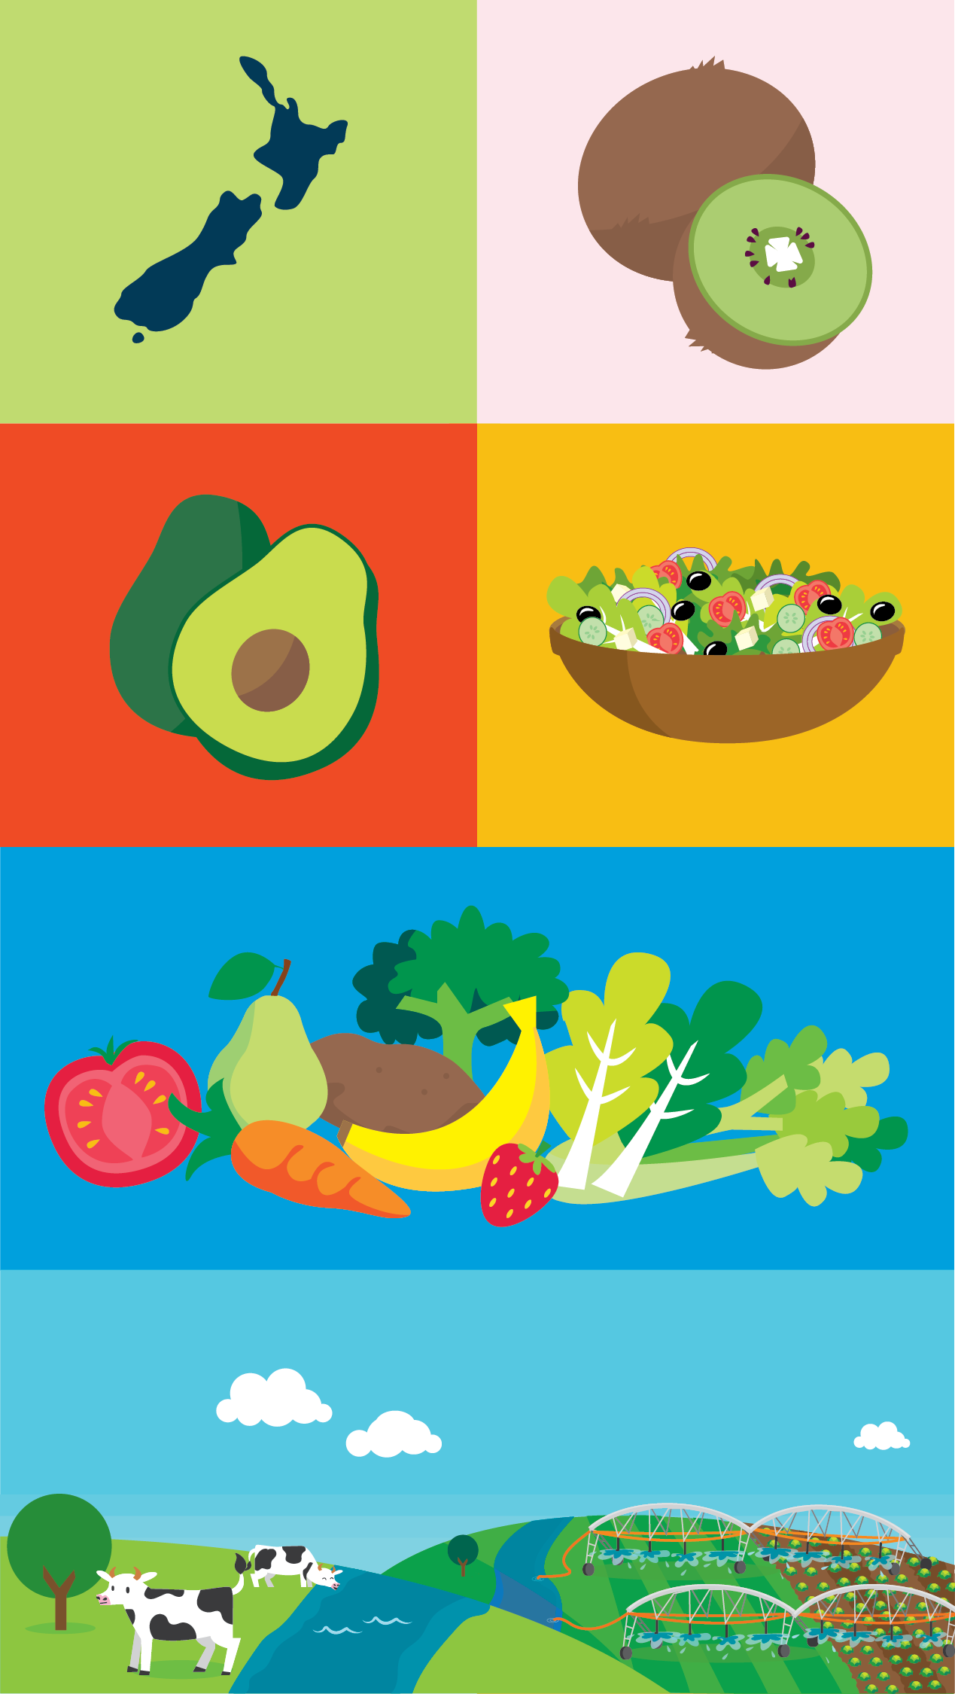
Agenda
About me
What is user testing
What is usability
What is a user
What can you test with users
Why you should do user testing
When should you do user testing
Key steps to user testing
What to do with user testing results

Slide 3
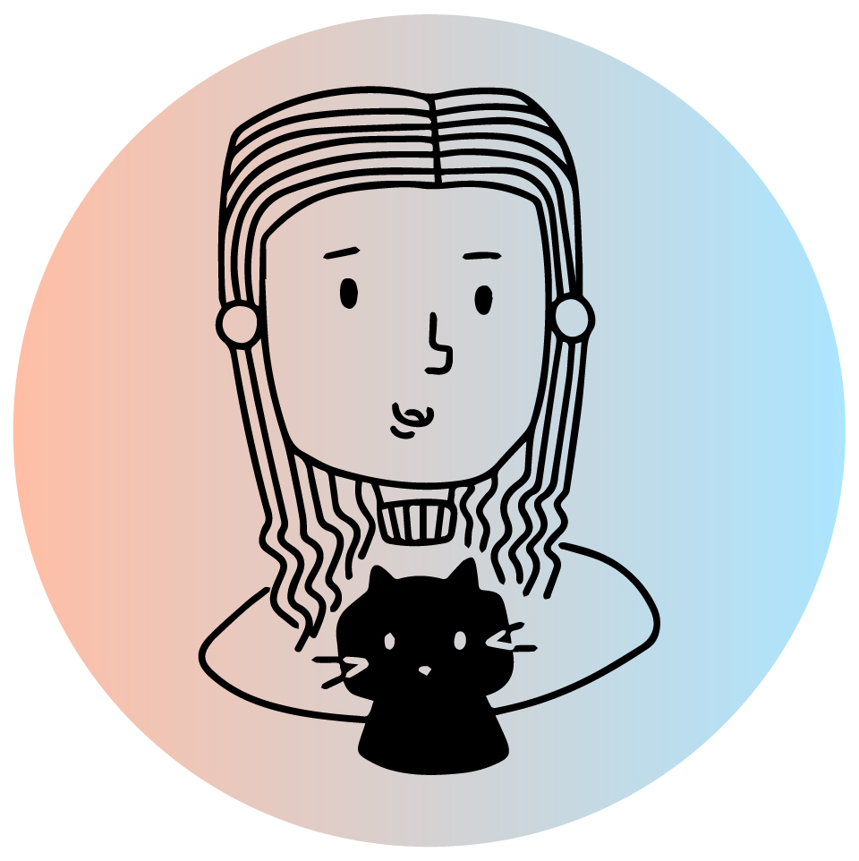
My name is Krystle and I am a service designer in the Food Risk Management Directorate
Notes:
Who am I?
Service designer for 6 years (2017-2019 in tech company, 2019 to present at MPI)
Neurodiverse (autism)
Customer service (payroll officer for 8 years, worked in various customer facing jobs)
Bachelors in nutrition & psych, masters in psych, quals in UX design
Projects: egg & chicken RMPs, Simply Safe & Suitable, Ka Ora, Ka Ako verifications, campy consumer ed, verification guidance
Tasks:
User research (e.g., interviewing, user testing, surveys, observations, service safari)
Data analysis (e.g., thematic analysis, simple stats)
Facilitating idea generation (i.e., ideation), developing prototypes
Supporting delivery, measuring product/service success
Promoting/advocating for accessibility & inclusion

Slide 4
What is user testing?
Also called usability testing
Type of research conducted with users (i.e., people using the product or service). The purpose of this research is to identify usability issues a product or service has.
Usability = user friendliness and functionality

Slide 5
What is usability?
Usability is how easy it is to use a product or service
Is it easily understood? Intuitive to use?
Is it error proof?
Can users remember how to use it?
Can users efficiently use it?
Is it pleasant to use?
Notes:
Source: https://www.interaction-design.org/literature/topics/usability

Slide 6
What is a ‘user’?
User = someone who uses a product or service.
Users can be your colleagues, consumers, food businesses, co-regulators

Slide 7
What can you test with users
Product and service:
In our case, we create training materials for verifiers, Food Act/Wine Act, Animal Product Act templates, notices, content for webpages, guidance materials (eg videos, posters, written web content, recall guidance)
Prototypes
These are mock ups of products and services, which are like draft product or trial version of a service
Notes:
Provide example of what a prototype can look like
Eg remote verification trial
Eg showing some people what a template can look like

Slide 8
When should you user test
At the start of a project, test the old product/service (ie design)
Test the prototypes created during development
Test new iterations of the prototype
Test implemented products/services to identify issues/problems
Notes:
Source https://www.nngroup.com/articles/usability-testing-101/

Slide 9
Why should we do user testing?
You are not the user. You know too much about how the product/service works. Testing takes away the guess work.
User testing can help you:
Identify problems
Identify areas for improvement
Understand how users use your product/service
Understand user preferences
User testing provides evidence for what needs to be improved
Notes:
Sources
https://www.nngroup.com/articles/usability-testing-101/
User Testing: Why & How (Jakob Nielsen)
https://youtu.be/v8JJrDvQDF4?si=3yroh97UeG6lJLQA

Slide 10
Make sure data is handled as per the consent forms
Put the data in useable format for analysis. I often use spreadsheets and Miro.
Rank importance of the findings – how crucial is it to implement the finding? Or is it a nice to have? How easy is it to do? How would it affect users?
Use the findings to enhance the actual product/service or prototype where applicable
Repeat testing and refine the product/service as needed
What to do with user testing data

Slide 11
Key steps of user testing
Identify the research question/goal
Create tasks to answer the research question
Pilot the test tasks with your team
Recruit realistic users
Conduct tests
Analyse data
Use data to amend actual product/service or prototype
Notes:
Identify the research question/goal – what do you want to learn/focus on?
Create tasks to answer the research question
Pilot the test with team – does the test work? What logistics need to be changed? Test technology
Recruit realistic users – your research based personas will help with that
Conduct tests
Consent
Adminsiter tasks to user
Have a note taker
Observe & ask questions
Be neutral but friendly – you don’t want to lead the user to a particular answer
Analyse data
Use data to amend actual product/service or prototype

Slide 12
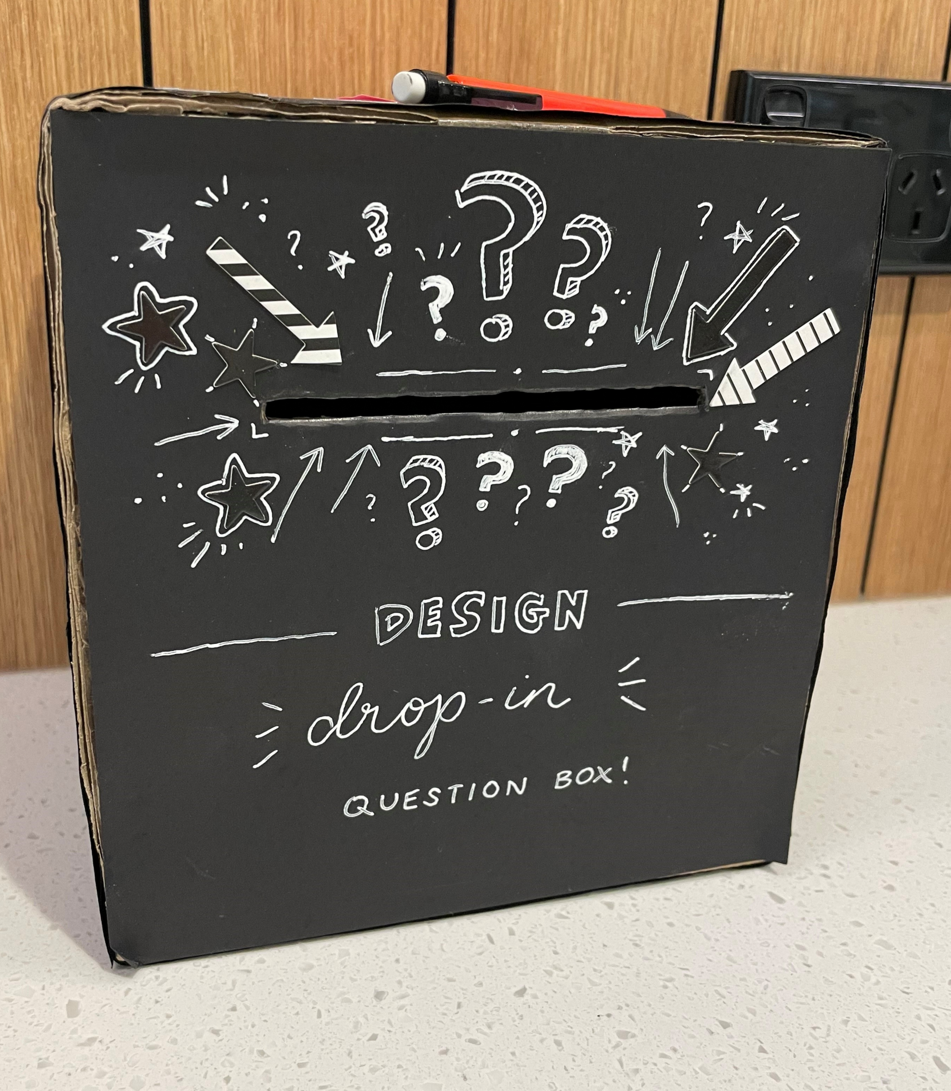
Feedback
Email DL_NZFS_Design DL_NZFS_Design@mpi.govt.nz
Or put your feedback into this box by the coffee machine on level 8 of Pastoral House
Notes:
Colours can affect the atmosphere of a space, which can then influence behaviour within that space

Slide 13
Resources
Usability testing 101
https://www.nngroup.com/articles/usability-testing-101/
Usability 101: introduction to usability
https://www.nngroup.com/articles/usability-101-introduction-to-usability/
Testing content with users
https://www.nngroup.com/articles/testing-content-websites/
Usability
https://www.interaction-design.org/literature/topics/usability
Informed consent
https://www.nngroup.com/articles/informed-consent/
Consent form template
https://media.nngroup.com/media/articles/attachments/NNg_Example_Consent_Form.pdf

Slide 14
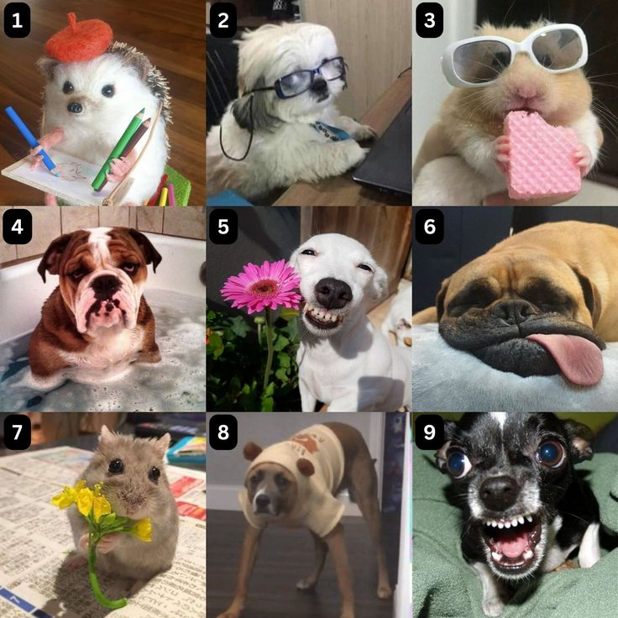
End of talk
gut check!
Which animal resonates with you after my talk today?
Add your number to the chat & a reason why ☺
Notes:
So that is the end of my korero
Feel free to add your number to the chat & a reason why ☺

Slide 15
Any pātai (questions)?
Notes:
Any questions?

Slide 16
Tēnā rawa atu koutou (thank you very much) for coming along and see you all next time ☺
Notes:
Kei te pai, tēnā rawa atu koutou (thank you) for coming along and see you all next time

