Slide 1


Enhancing
accessibility
Notes:
Kia ora koutou and welcome to today’s talk.
Today’s topic is enhancing accessibility. Krystle and I/Alesha and I will be sharing what accessibility means, why it is important and sharing some practical tips to enhance the work you do to make content more accessible and inclusive.

Slide 2
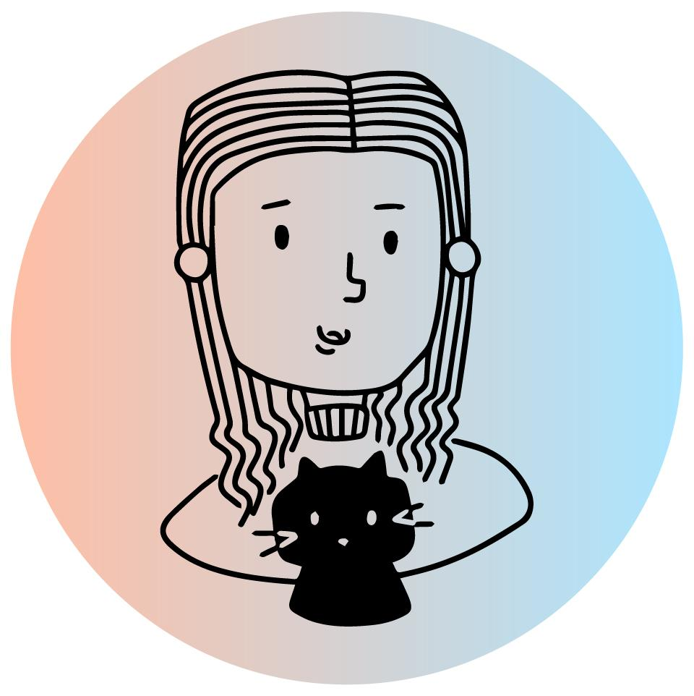
Who are we?
My name is Krystle Chester
Neurodivergent
Masters in psych
Service designer
Designing products and services with users in mind. This means advocating for the user by understanding their needs through research and involving them in the design process as much as possible!
Notes:
Who am I?
My name is Krystle Chester
Neurodivergent
Masters in psych
Service designer
Designing products and services with users in mind. This means advocating for the user by understanding their needs through research and involving them in the design process as much as possible!

Slide 3
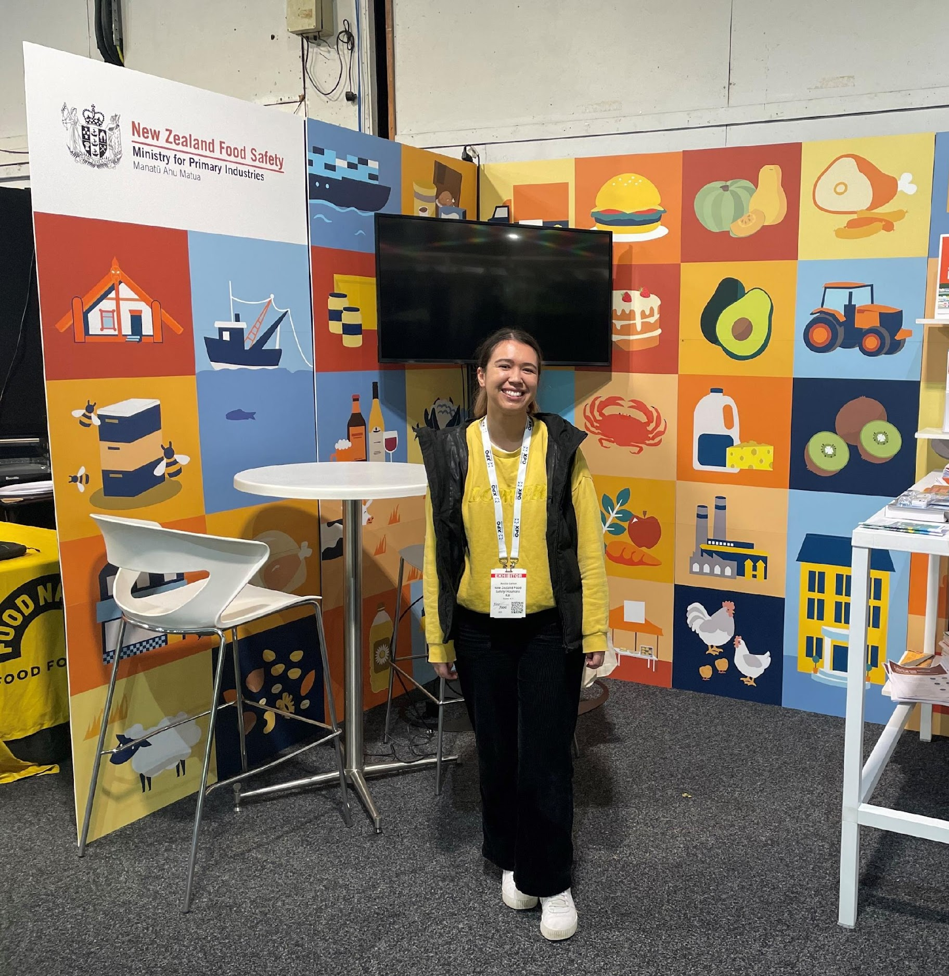
Who are we?
My name is Alesha Garton
and I’m a Senior Visual Designer in the Food Regulation directorate.
Bachelors in design (majoring in visual communication design)
Notes:
Alesha Garton, Senior Visual Designer in the Food Regulation directorate. I have a Bachelor of Design with Honours (majoring in visual communication design). My expertise and experience in visual communication design allows me to effectively convey content to customers, stakeholders and colleagues. Part of this involves understanding who the audience is and allowing space for iteration to ensure their voice is heard.
We’re looking forward to sharing insights and practical tips today

Slide 4
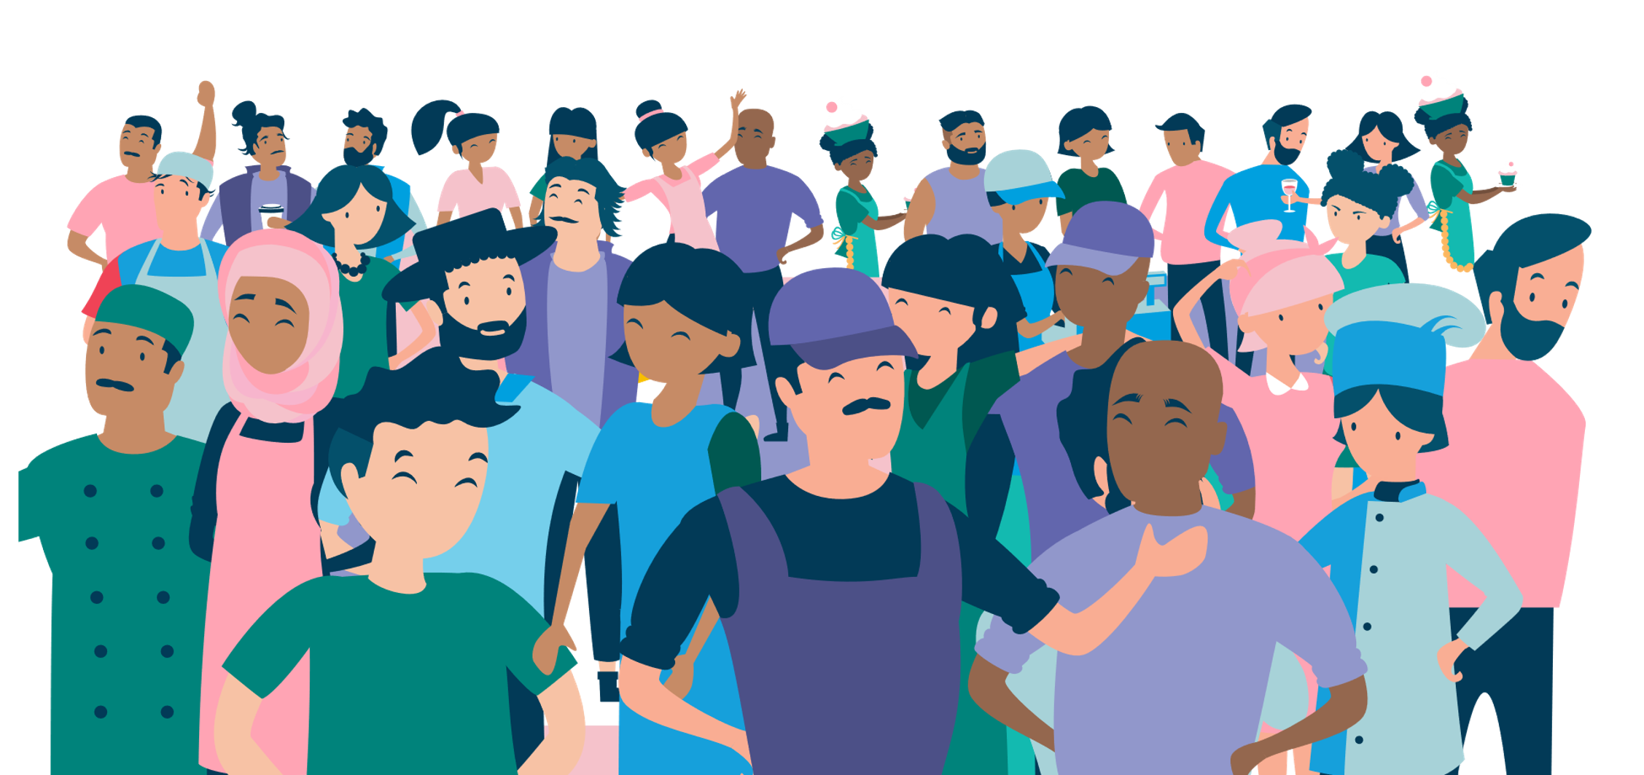
What do we mean by ‘accessible’?
To design for accessibility means to be inclusive to the needs of your users.
The work we create is useful when it’s accessible to any user, anywhere, anytime. Accessibility is all about people.
Notes:
When Krystle and I say ‘accessible’ what do we mean?
To design for accessibility means to be inclusive to the needs of your users.
The work we create is useful when it’s accessible to any user, anywhere, anytime. Accessibility is all about people.

Slide 5


Accessible design is better for everyone
1 in 4 New Zealanders have a physical, sensory, learning, mental health or other disability. Stats NZ, 2013
Notes:
1 in 4 New Zealanders have a physical, sensory, learning, mental health or other disability. Stats NZ, 2013
If it works for the 1 in 4 New Zealanders (25%), it should also work for the rest
The goal we’re working towards is ensuring everyone can access the rules, guidance and other information.

Slide 6
Estimated that
1-2%
1-2%
Only
16%
of the population
have autism
are diagnosed with ADHD
of NZ adults are considered to have high literacy levels.
research estimates up to
5%
Estimated that
10%
some research says up to
People may also be unfamiliar with the subject matter and related jargon and/or have poor computer skills.
8%
of the population
are dsylexic
Notes:
Estimated that 1-2% of pop have autism
Estimated that 10% of pop are dsylexic
1-2% are diagnosed with ADHD, research estimates up to 5%, some research says up to 8%
Only 16% of NZ adults are considered to have high literacy levels. People may also be unfamiliar with the subject matter and related jargon and/or have poor computer skills
Sources
12% are considered to have lower literacy, level 1 or lower. (reading level of an 11 year old or younger). 16% on level 4/5 literacy, see table 1 in https://workresearch.aut.ac.nz/__data/assets/pdf_file/0008/522827/An-empirical-portrait-of-New-Zealand-adults-living-with-low-literacy-and-numeracy-skills_report.pdf
Autism prevalence in New Zealand - Altogether Autism
ADHD is more common than you think | ADHD NZ - ADHD NZ
https://dfnz.org.nz/wellbeing/

Slide 7
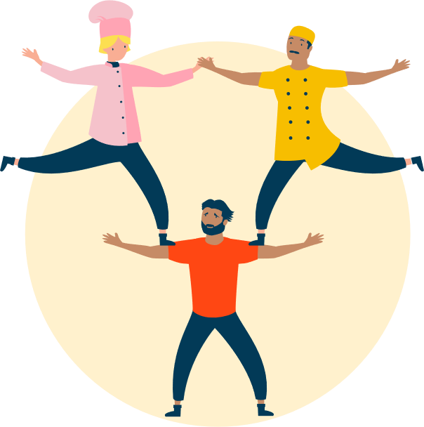


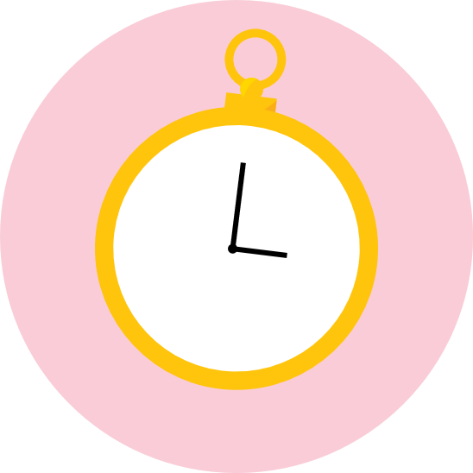
People have a range of functional abilities
Literacy levels, memory and attention
Sensory abilities like sight and hearing
Physical abilities
Temporary disabilities
Notes:
People have a range of functional abilities
All too often services are designed with the perfect user in mind. But people’s functional abilities vary hugely.
People's literacy levels, memory and attention vary due to conditions such as dyslexia, ADHD, dementia and stress.
Sight and hearing ranges from perfect to none and people may perceive information differently e.g. people with autism can be very literal, people with dyslexia may experience letters jumping around
Physical ability varies with differences in mobility, dexterity, strength and levels of pain. And as we get older our functional abilities deteriorate.
We also all experience temporary disabilities caused by illness or injury. And situational disabilities can arise such as not being able to hear well due to being in a noisy room or not being able to see well due to bright sunlight.
We need to deliver products and services that accommodate the range of abilities that the people using them actually have.

Slide 8
Why enhanced accessibility is needed
1
2
3
People can feel excluded if content is inaccessible
Accessible materials makes things more transparent and therefore enhances trust
It’s our obligation as govt workers to ensure that our info is accessible.
4
5
Accessibility removes the barriers and makes things easier, which supports behaviour change. If something is easier to do, then it is more likely to happen.
Helps reach a larger audience
Notes:
Look at 100 things designers need to know for evidence
Talk about impact on yourself
For example,
People can feel excluded if content is inaccessible
Accessible materials makes things more transparent and therefore enhances trust. If we make things easier to use and access then people are more likely to use it
its our obligation as govt workers to ensure that our info is accessible.
Accessibility removes the barriers and makes things easier, which supports behaviour change. If something is easier to do, then it is more likely to happen.
Helps reach a larger audience. So if its work for the NZ’ers who have a physical, sensory, learning, mental health or other disability, it will work for those who don’t
Source
https://www.digital.govt.nz/standards-and-guidance/design-and-ux/accessibility/accessible-language/
Dr. Doug McKenzie-Mohr, https://cbsm.com
[link]
https://www.digital.govt.nz/standards-and-guidance/design-and-ux/accessibility/
https://www.digital.govt.nz/standards-and-guidance/design-and-ux/accessibility/

Slide 9
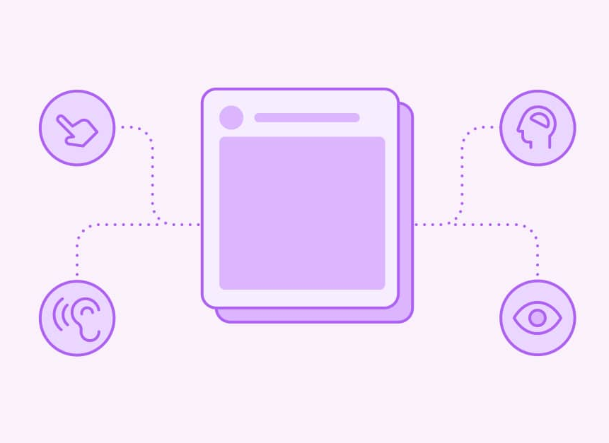
Ways you can apply design to enhance accessibility of your work
Notes:
Ways you can apply design to enhance accessibility of your work

Slide 10
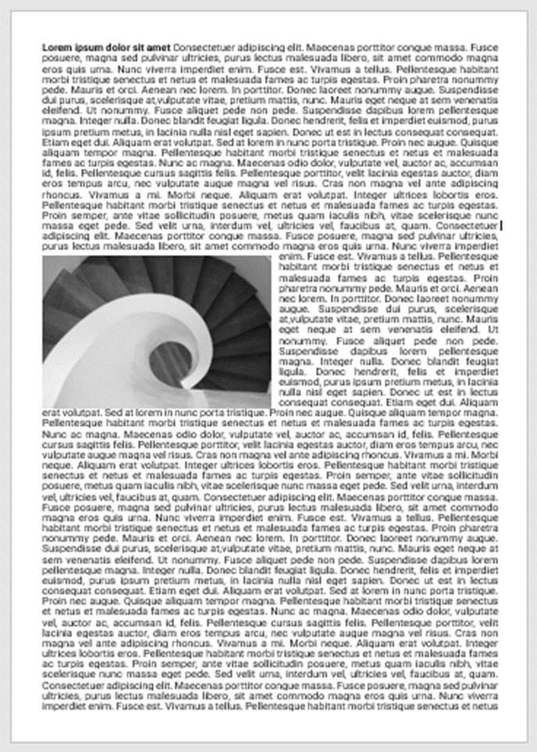
Make written content easier to scan
Large walls of text are difficult for most people to read, it makes it harder to scan for information they need.
Autistic & ADHD people may struggle to focus on long passages of text, causing frustration.

Slide 11
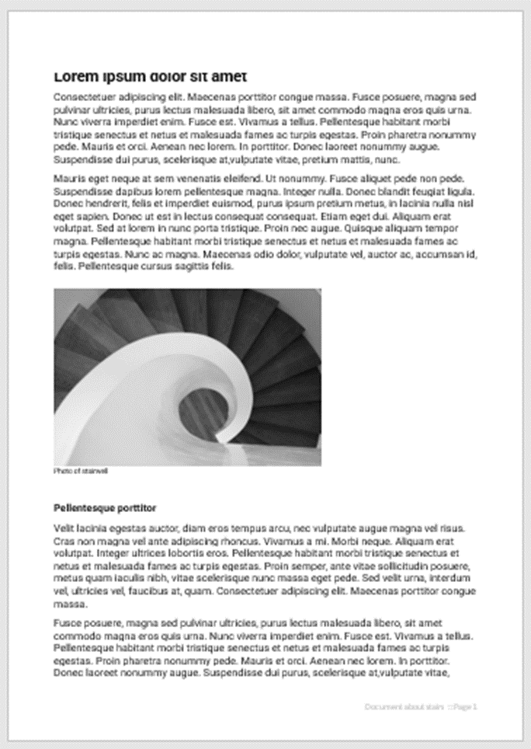
Make written content easier to scan
vs.

Slide 12
Make written content easier to scan
Use headings, subheadings, and bullet points to break up your text
Use ‘styles’ in Word – this helps create a contents page and appear in the Navigation pane, which helps readers scan and navigate through the document
Use descriptive headings
Distinguish important information by highlighting it in some way (eg with bold letters or colour).
Group related information
Notes:
Large walls of text are difficult for most people to read. Autistic & ADHD people may struggle to focus on long passages of text, causing frustration.
Use headings, subheadings, and bullet points to break up your text & make them descriptve
Distinguish important information by highlighting it in some way (eg with bold letters or colour).
Signpost sections and group related information
Use styles
Text size,
type face &
line spacing,

Slide 13

Make written content easier to scan
Aa
Aa
Aa
HEY
12 pt
Easy to read typefaces like Arial & Calibri
Use italics and bolding text sparingly.
At least 1.2 spacing
One line between paragraphs
Avoid all capital letters
Text size at least 12 point
Notes:
Large walls of text are difficult for most people to read. Autistic & ADHD people may struggle to focus on long passages of text, causing frustration.
Use headings, subheadings, and bullet points to break up your text & make them descriptve
Distinguish important information by highlighting it in some way (eg with bold letters or colour).
Signpost sections and group related information
Use styles
Text size,
type face &
line spacing,

Slide 14
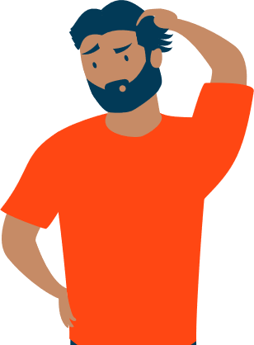
Use plain language
Using complex, metaphoric, jargonistic language can create barriers to understanding.
This is can be a barrier for autistic people, people who speak English as a second language, and people with low literacy.
Before | After
Attain | Meet
Comply with | Follow
Implement | Carry out/start
Retain | Keep
Pertaining to | About, of or on
Notes:
Using complex, metaphoric language and marketing jargon can create barriers to understanding. Particularly for autistic people are more likely to take phrases and expressions literally.
Avoid words and expressions that may have more than one meaning. “Engagement” for example, is a term often used to describe a work meeting. But for people who have a literal understanding of language might think of marriage. A way to check is to Google the word and if it has multiple meanings, consider using a different word
Be as clear and specific as possible.
Write to level 2, that is, year 7 (12 years old) – readability tools like Hemingway and Readability tool can help you
Mention Hemingway App & Readability Tool
Sources
https://www.stylemanual.gov.au/writing-and-designing-content/clear-language-and-writing-style/plain-language-and-word-choice
Use simple words and phrases (plainlanguage.gov)

Slide 15
Use plain language
1
2
3
Be as clear and specific as possible
Use active voice
First person
(e.g. you, me, we, our etc)
4
5
6
Short sentences
Simple, every day
words. Avoid words and expressions that may have more than one meaning
Write to level 2 (12 years old).
Notes:
Be as clear and specific as possible.
Use active voice
First person (e.g. you, me, we, our etc)
Short sentences
Simple, every day words. Avoid words and expressions that may have more than one meaning. “Engagement” for example, is a term often used to describe a work meeting. But for people who have a literal understanding of language might think of marriage. A way to check is to Google the word and if it has multiple meanings, consider using a different word/phrase.
Write to level 2, that is, year 7 (12 years old). Use Hemingway App & Readability Tool are helpful for checking the readability of writing
Sources
https://www.stylemanual.gov.au/writing-and-designing-content/clear-language-and-writing-style/plain-language-and-word-choice
https://www.stylemanual.gov.au/writing-and-designing-content/clear-language-and-writing-style/

Slide 16
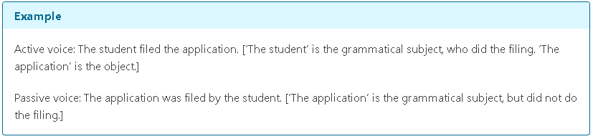
Use plain language
Notes:
Be as clear and specific as possible.
Use active voice
First person (e.g. you, me, we, our etc)
Short sentences
Simple, every day words. Avoid words and expressions that may have more than one meaning. “Engagement” for example, is a term often used to describe a work meeting. But for people who have a literal understanding of language might think of marriage. A way to check is to Google the word and if it has multiple meanings, consider using a different word/phrase.
Write to level 2, that is, year 7 (12 years old). Use Hemingway App & Readability Tool are helpful for checking the readability of writing
Sources
https://www.stylemanual.gov.au/writing-and-designing-content/clear-language-and-writing-style/plain-language-and-word-choice
https://www.stylemanual.gov.au/writing-and-designing-content/clear-language-and-writing-style/

Slide 17
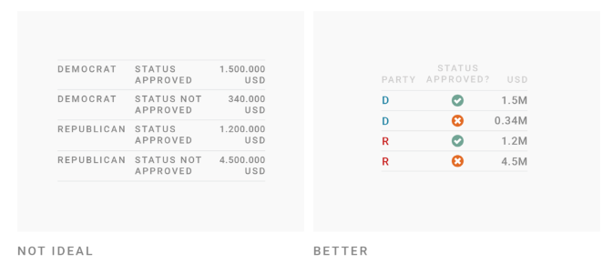
Use tables only if it makes content easier to read
Use a table only if there isn’t a simpler way to present your content, such as a list, paragraph of text or diagram.
Notes:
Try to keep tables to one page
If they carry across make sure that headers carry across too
Use tables if you want to enable readers to look up specific information. Readers will be able to find the data that applies to them
https://www.stylemanual.gov.au/structuring-content/tables
https://taras-bakusevych.medium.com/data-tables-design-3c705b106a64

Slide 18
When you do use tables, make sure you:
1
2
3
Include a title and row and column headings
Try to keep tables to one page. If they carry across make sure that headers carry across too
Keep tables as simple as possible
6
Don’t leave cells empty. Use ‘zero’ or ‘nil’ or 'n/a' where there is no data. If it is numeric data, use the numeric zero (0). Only use zero if that is the true value
4
5
Add notes below the table to help users understand the information and where it comes from
Don’t rely on colour as the only visual means of conveying information in tables
Notes:
Try to keep tables to one page
If they carry across make sure that headers carry across too
https://www.stylemanual.gov.au/structuring-content/tables

Slide 19
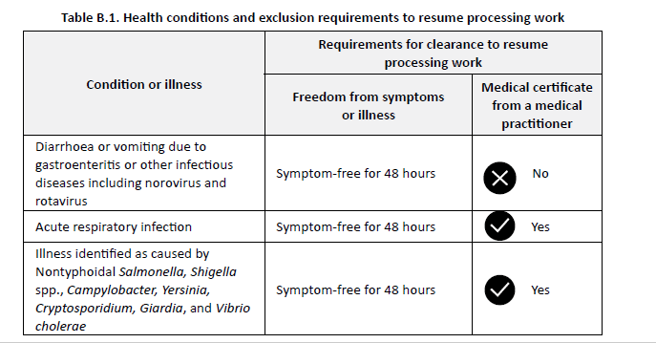
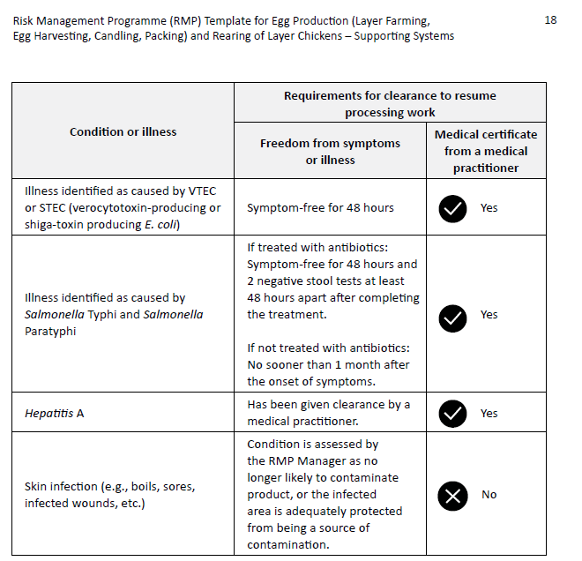
In this example the table spans across two pages
The headers are repeated so the reader can see what each column refers to
Notes:
Try to keep tables to one page
If they carry across make sure that headers carry across too
There’s other rules, see below. Would be good if you can show them on the image
https://www.stylemanual.gov.au/structuring-content/tables

Slide 20
Use images to support written information
You can use images to demonstrate a point, describe a complex idea. Images are great way to complement written content and are helpful to visual learners, people with lower literacy, autistic people.
Notes:
You can use images to demonstrate a point, describe a complex idea. Images are great way to complement written content and are helpful to visual learners , people with lower literacy, autistic people.
Images support understanding of complex ideas (SSS survey results, images increased understanding of complex ideas – 82% found the cooling food image easy to understand)

Slide 21



Using images to support written information
Aa
Make sure colours contrast well
Use descriptive alt text for screen readers
Keep the image simple
Avoid harsh neon, clashing colours
Notes:
You can Use images to demonstrate a point, describe a ;complex idea. These could be images found online.
However,
Avoid neon, clashing colours
Make sure colours contrast well
Use descriptive alt text
Keep the image simple

Slide 22
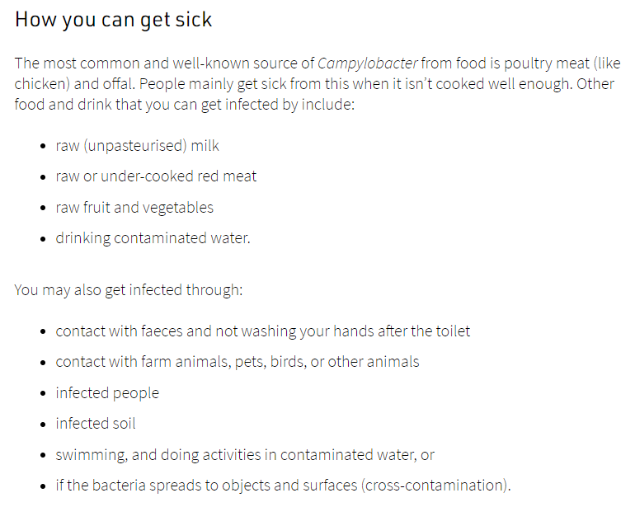
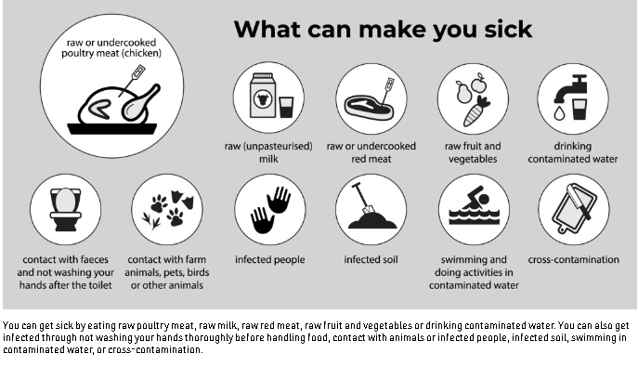
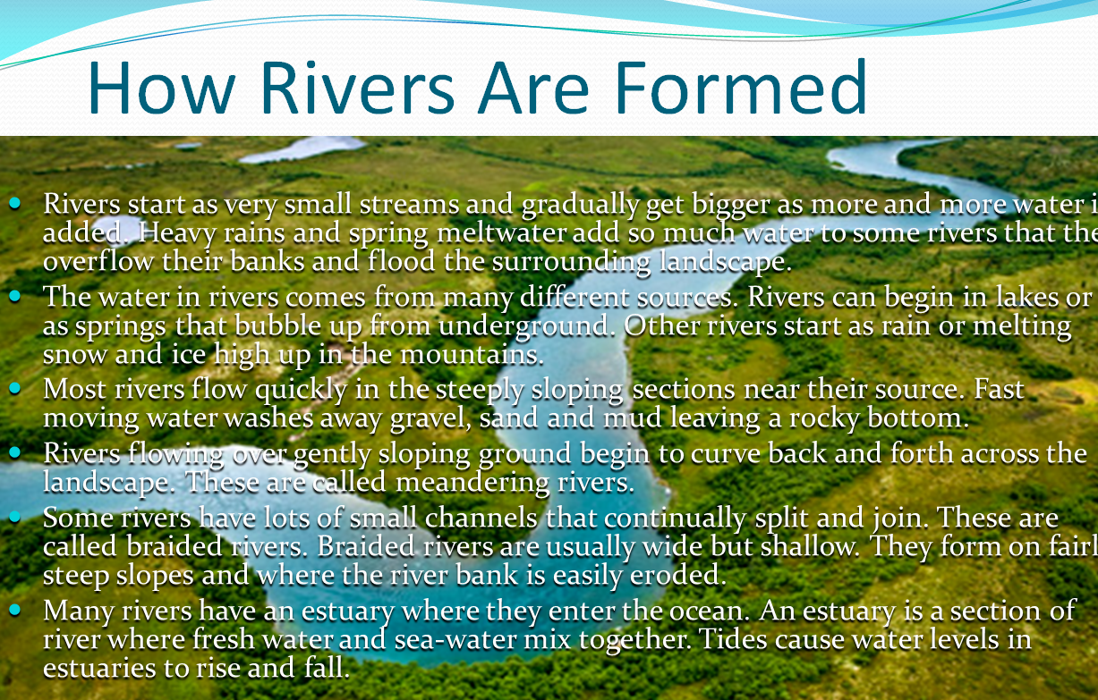
Using images to support written information
Notes:
Source of image
https://www.mpi.govt.nz/food-safety-home/food-poisoning-symptoms-causes/campylobacter-infection-symptoms-advice/

Slide 23
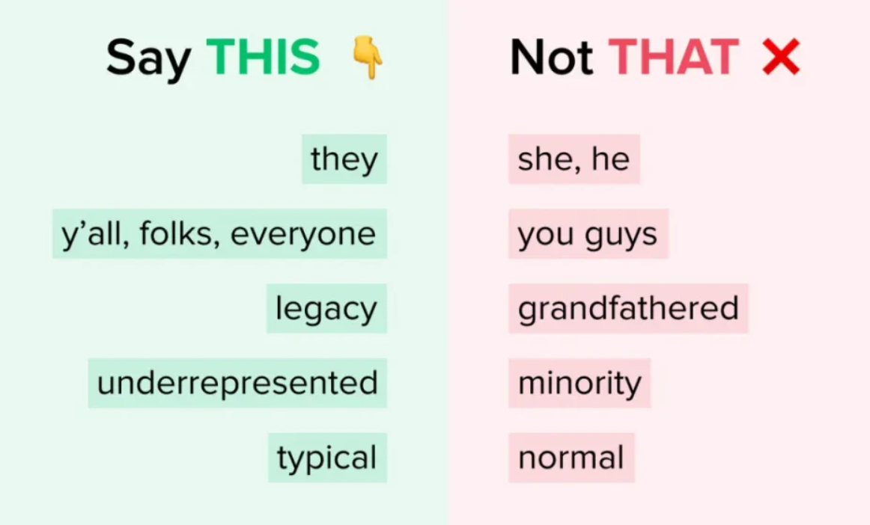
Use inclusive language
Respect diversity by using inclusive language
Notes:
Sources
https://www.stylemanual.gov.au/accessible-and-inclusive-content/inclusive-language/gender-and-sexual-diversity
https://www.stylemanual.gov.au/accessible-and-inclusive-content/inclusive-language/people-disability
https://www.stylemanual.gov.au/accessible-and-inclusive-content/inclusive-language/age-diversity

Slide 24
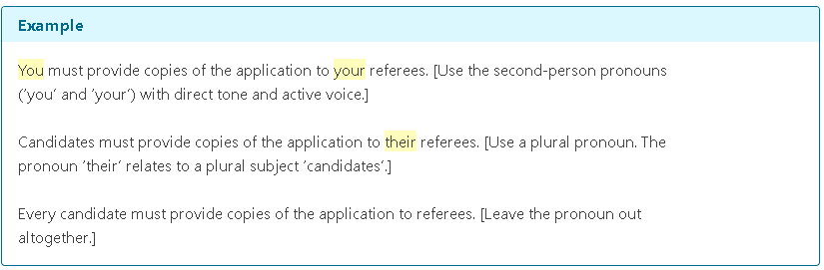
Use inclusive language
Use gender neutral language (e.g. they/them instead of he/she)
Notes:
Gender neutral language
– they/them instead of he or her
- avoiding gendered job titles
Sources
https://www.stylemanual.gov.au/accessible-and-inclusive-content/inclusive-language/gender-and-sexual-diversity
https://www.stylemanual.gov.au/accessible-and-inclusive-content/inclusive-language/people-disability
https://www.stylemanual.gov.au/accessible-and-inclusive-content/inclusive-language/age-diversity

Slide 25
Use inclusive language
Use person-first language when you don’t understand individual or community preferences (e.g. person with disability, person who is hard of hearing or deaf)
“people with disabilities”
“Baby Boomers, Generation X, Millennials, Generation Z”
Avoid referring to a person’s age or an age group if it’s not relevant
Notes:
Use respectful language
Avoid using the disability as an adjective that defines the person, unless that is their preference. Use the word ‘disability’ as an uncountable noun.
Use person-first language when you don’t understand individual or community preferences. Describe the person and then the characteristic. Do research to get a better understanding.
Question whether age is relevant. Avoid referring to a person’s age or an age group if it’s not relevant.
It does not communicate a person's maturity, experience, or physical or mental capability. Unnecessary reference to age can contribute to exclusion, ageism, or discrimination. (https://www.digital.govt.nz/standards-and-guidance/design-and-ux/content-design-guidance/inclusive-language/age-inclusive-language)
Sources
https://www.stylemanual.gov.au/accessible-and-inclusive-content/inclusive-language/gender-and-sexual-diversity
https://www.stylemanual.gov.au/accessible-and-inclusive-content/inclusive-language/people-disability
https://www.stylemanual.gov.au/accessible-and-inclusive-content/inclusive-language/age-diversity
https://www.digital.govt.nz/standards-and-guidance/design-and-ux/content-design-guidance/inclusive-language/

Slide 26
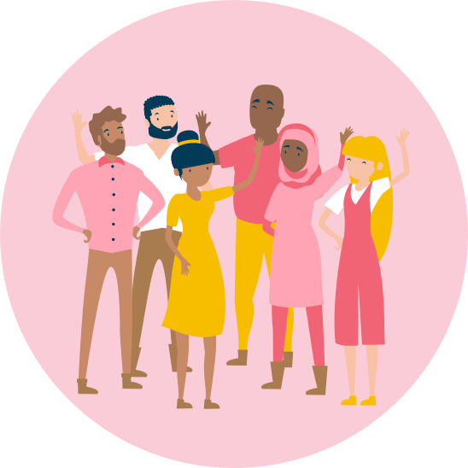
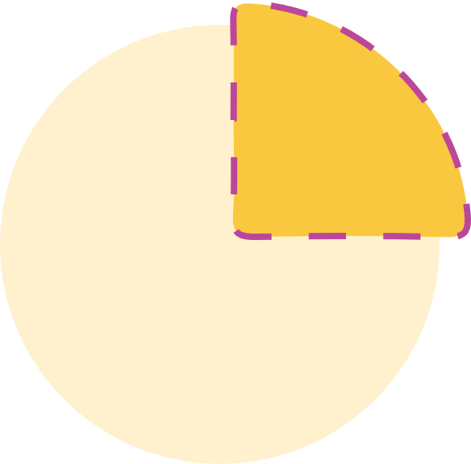
Recap of the session
Make content easier to scan
Use tables only if it simplifies your message
Use images to support your message
Use plain & inclusive language
To design for accessibility means to be inclusive to the needs of your users
Create for the 25% as it should work for the majority
Notes:
Recap of the session:
To design for accessibility means to be inclusive to the needs of your users
Create for the 25% as it should work for the majority
Think about how your user will interact with the work you create
Mention the resource of useful tools and links that’ll be sent around with these slides

Slide 27
What’s next
29 August 2024 Designing for neurodivergents part 2: Dyslexia
5 September 2024 Designing for neurodivergents part 3: Dyscalculia
10 October 2024 Why you should include users/customers in your projects and how to include them
7 November 2024 Sharing user research insights over the years

Slide 28
How did you feel about this talk?
Use react buttons to show how you feel
Do you have any feedback for me? What can be improved? What should we continue?
What else do you want to hear about?
Any guest speakers you want to hear from? Would you like to present on a topic?
Notes:
Use react buttons to show how you feel
Do you have any feedback for me? What can be improved? What should we continue?
What else do you want to hear about?
Any guest speakers you want to hear from?

Slide 29
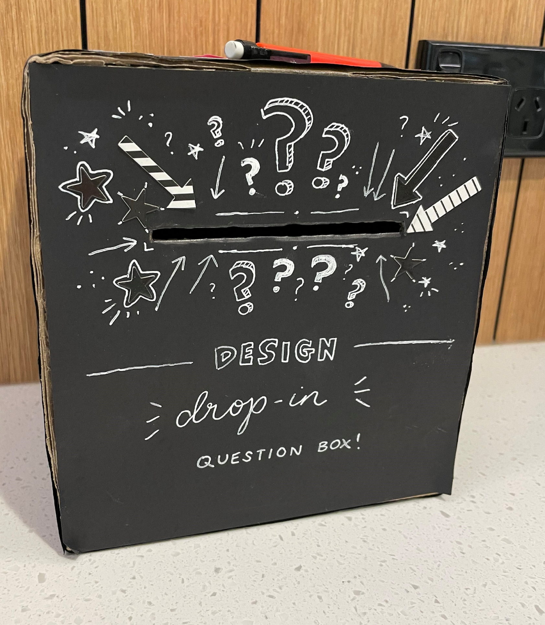
Feedback?
Email DL_NZFS_Design DL_NZFS_Design@mpi.govt.nz
Or put your feedback into this box by the coffee machine on level 8 of Pastoral House

Slide 30

Want to hear more?
Join our distribution list, DL Design Drop In https://selfserviceportal.intranet.mpi.govt.nz/DistributionLists .
Or find us on search for MPI_Design Drop Ins_Team in Viva Engage
Email us at DL_NZFS_Design DL_NZFS_Design@mpi.govt.nz

Slide 31

Tēnā rawa atu koutou (thank you very much) for listening to us speak about accessibility ☺
We’ll share some extra tools and helpful links about accessibility after this!

