Slide 1



Nau mai (welcome) to the ‘What on Earth is Design’ drop-in: Designing for neurodiversity part 2: Dyslexia
Hosted by the Designers
in the Food Risk Management team
Notes:
Image by Alesha Garton
Welcome to the what on earth is design drop in space
These meetings are an informal channel for the Food Regulation designers to share our knowledge, skills and the work we have done in Food Reg and across NZFS. We believe in sharing what we know to empower you to enhance the work you do and provide you with new learnings or practical things you can apply to your work
Disclaimer: I am still learning and aiming for progress, not perfection. These slides and talk are based on my own reading and not the opinion of MPI.

Slide 2
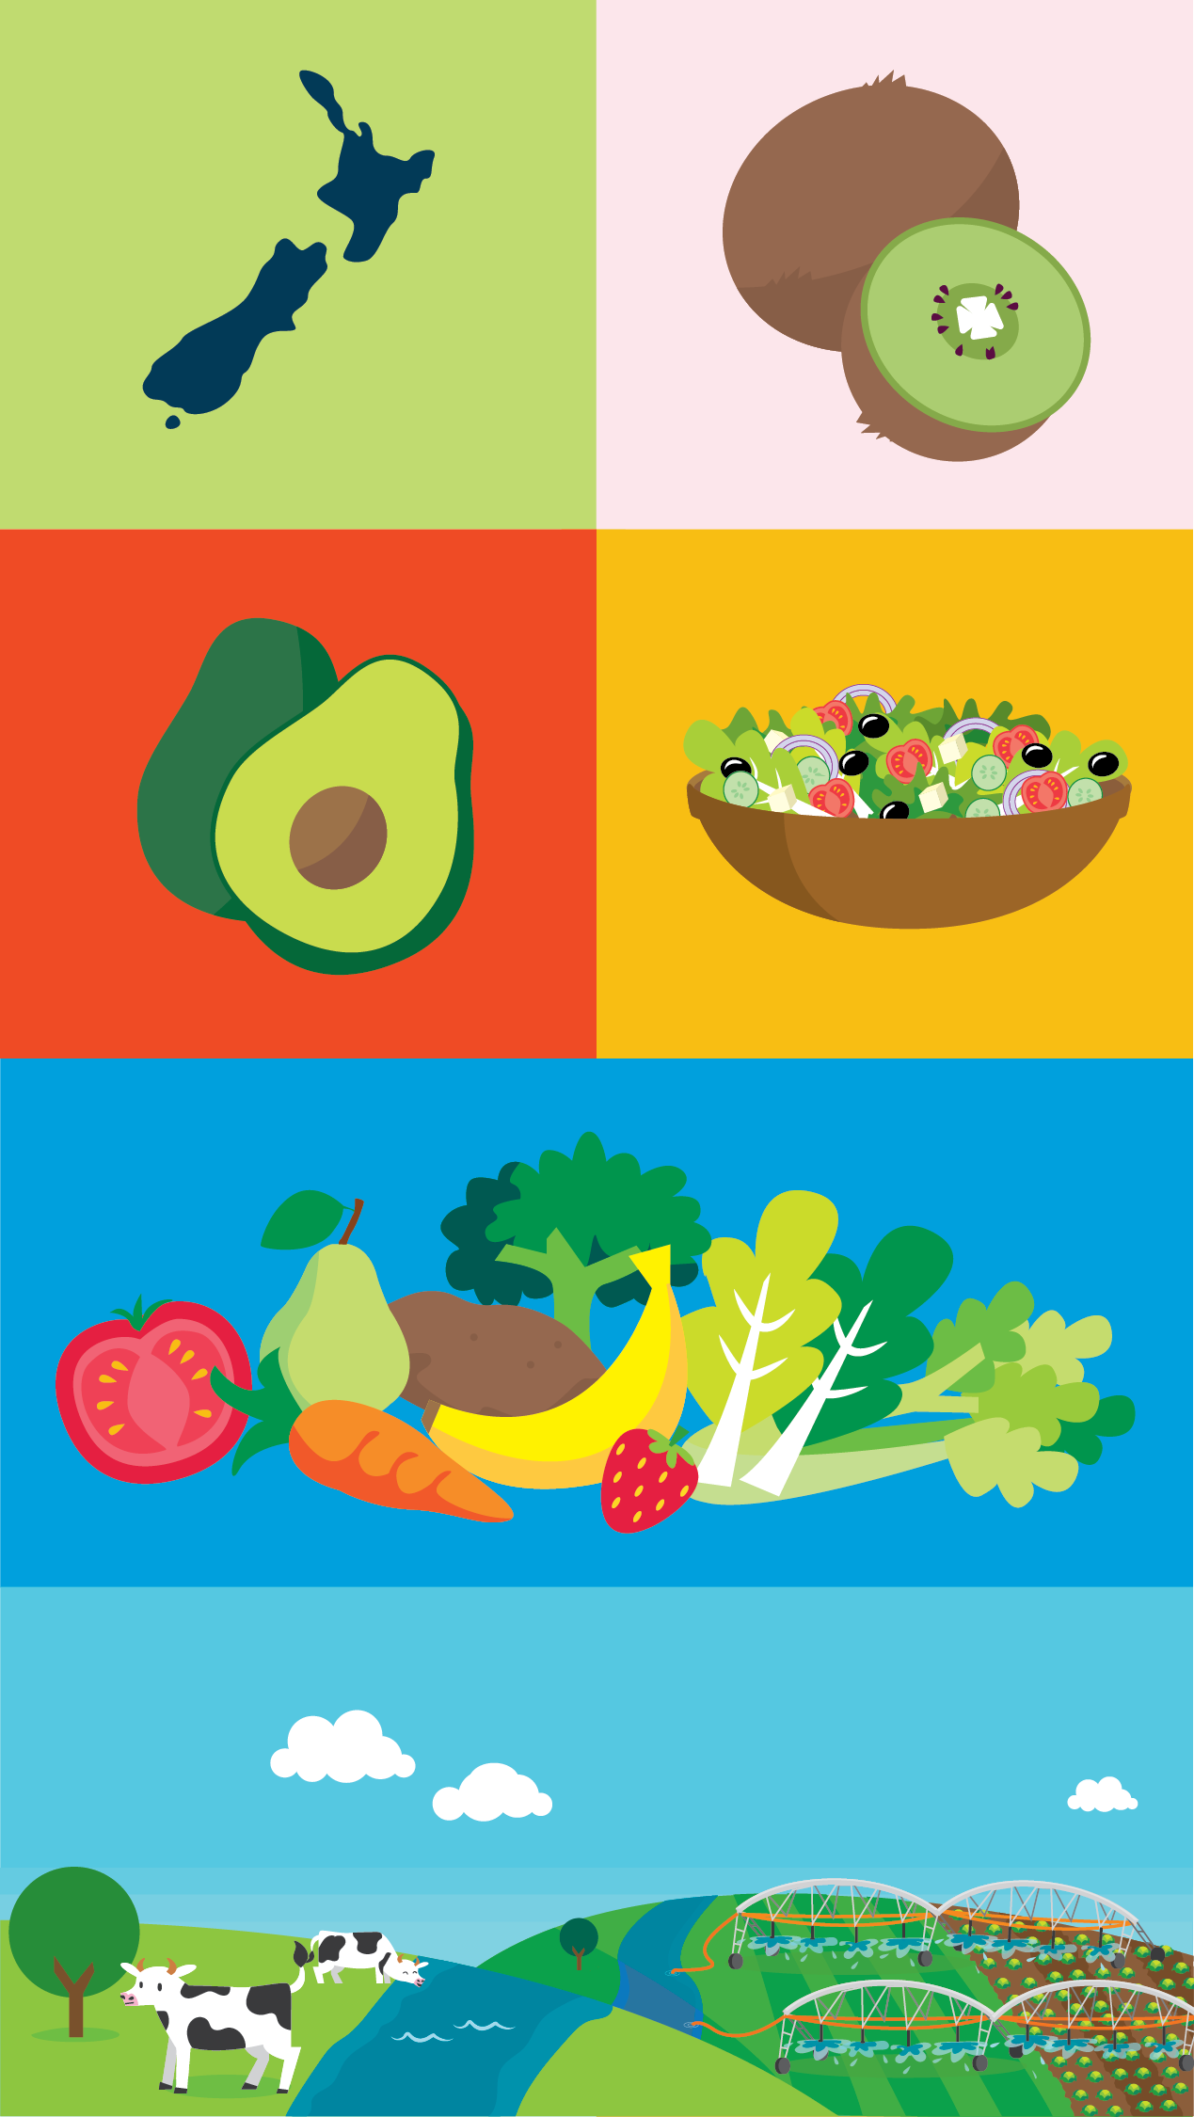
Agenda
About me
What is design?
What has been designed by Food Risk Management?
What does neurodivergent mean?
What is dyslexia?
How can you help?
Feedback and resources
Notes:
Image by Alesha Garton

Slide 3
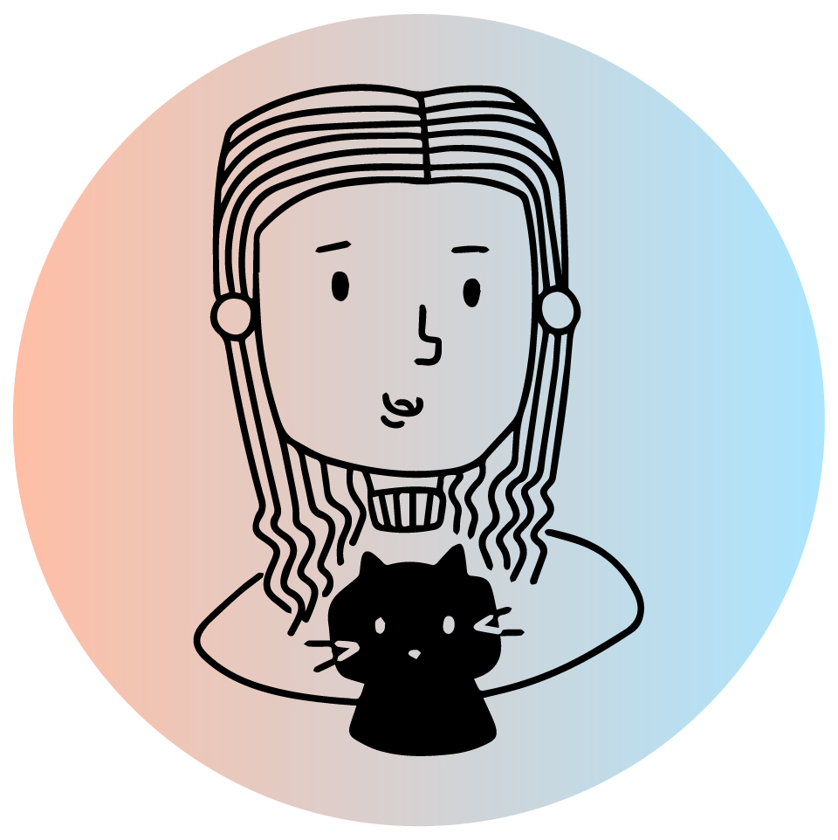
My name is Krystle Chester and I am a service designer
My role is about:
Advocating for users
Understanding user needs through research
Involving users in the design process as much as possible!
Testing materials and services with users
Promoting inclusive design
Notes:
Image by Annalise Chan

Slide 4
What is design?
“Design is a discipline of study and practice focused on the interaction between a person — a ‘user’— and the man-made environment, taking into account aesthetic, functional, contextual, cultural and societal considerations.”
Notes:
Reference
https://www.theicod.org/en/professional-design/what-is-design/what-is-design

Slide 5
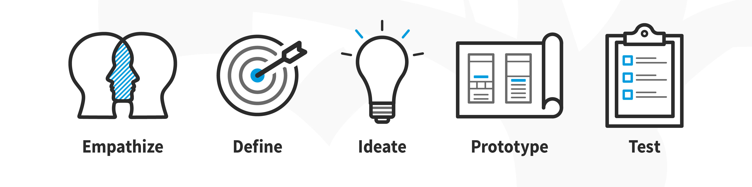
What is design?
“The basic definition of the word ‘design’ is simply to plan something in advance.”
Notes:
Reference
https://www.interaction-design.org/literature/article/what-is-design
Image source
https://www.interaction-design.org/literature/article/what-is-design-thinking-and-why-is-it- so-popular

Slide 6
Design components and considerations
Content – what is said and how it is said
Visual communication – how it looks, how things are communicated without words, colour, images, icons, graphs, infographics
Lay out / structure – use of space, headings, lists, order
Format – video, audio, print, web, PDF, Word
Typography – font style, font size, spacing between characters, character size, character differentiation
Findability/searchability – use of key words, web placement, distribution of product

Slide 7

Design is part of everyone’s job
Notes:
Stock image

Slide 8
What have we designed at Food Safety?
Videos, posters, booklets, web pages to explain food safety rules to businesses
Support and education for verifiers and RAs – for example, Food Safety Academy, other guidance and training materials
Processes – remote verifications, remote checks, school kitchen verifications, verifier recognition and professional development

Slide 9
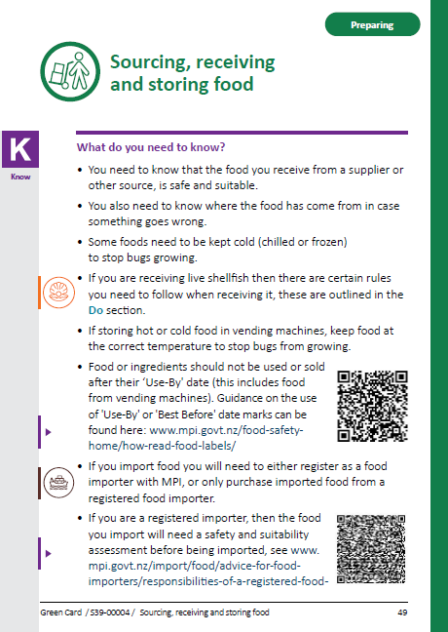
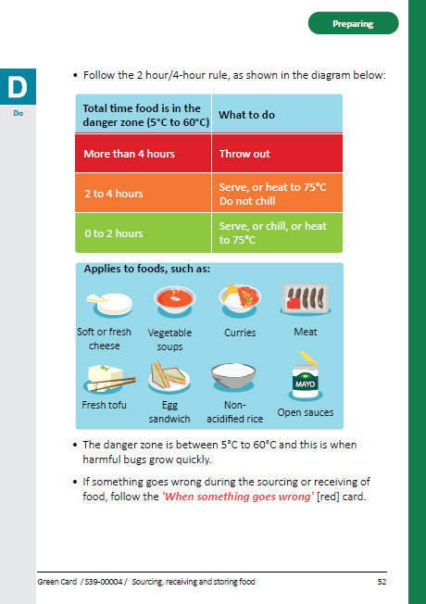
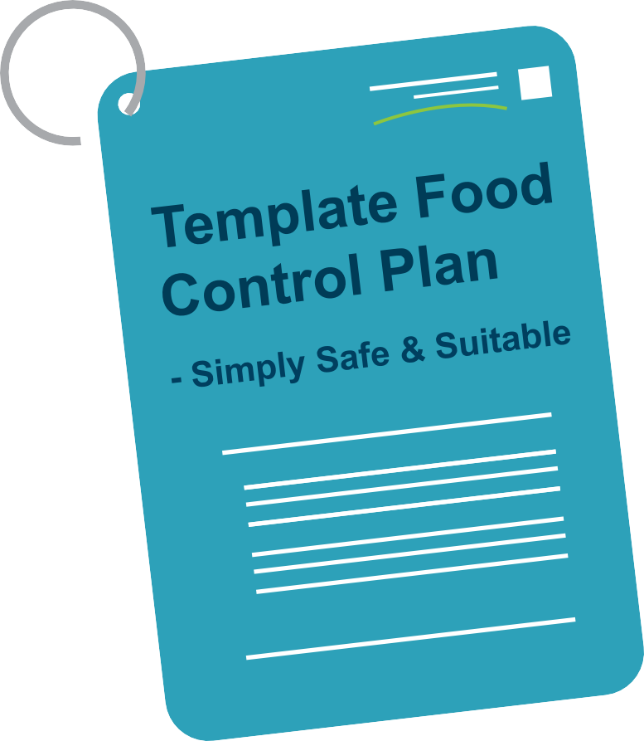
Simply Safe & Suitable
Notes:
Images provided by Alesha Garton
Starting off let’s chat about SSS
Food businesses are required to be registered under a template.
These describe the how to ensure food is safe and suitable/meet the requirements of the Food Act.

Slide 10
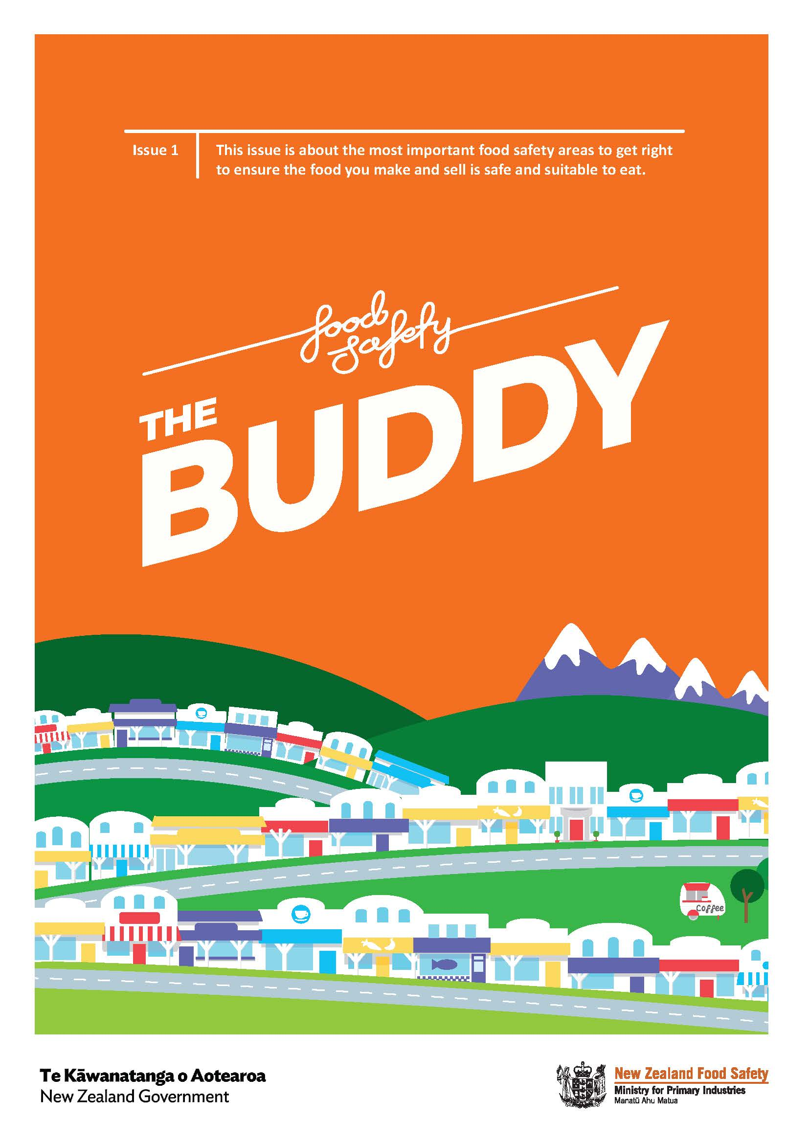
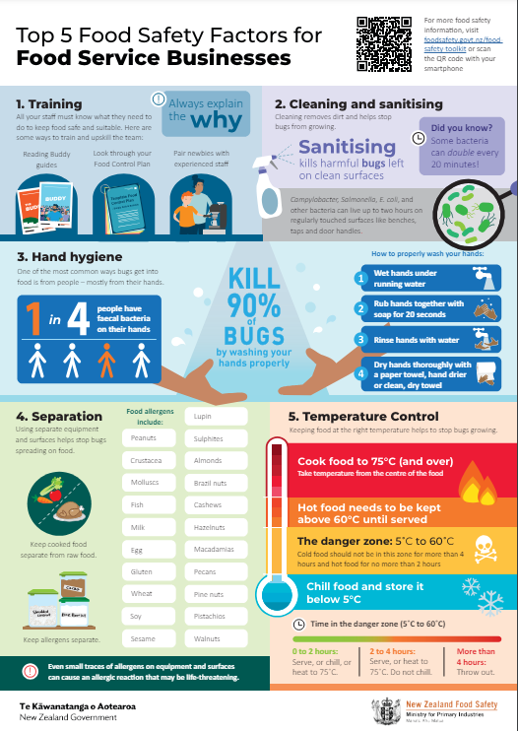
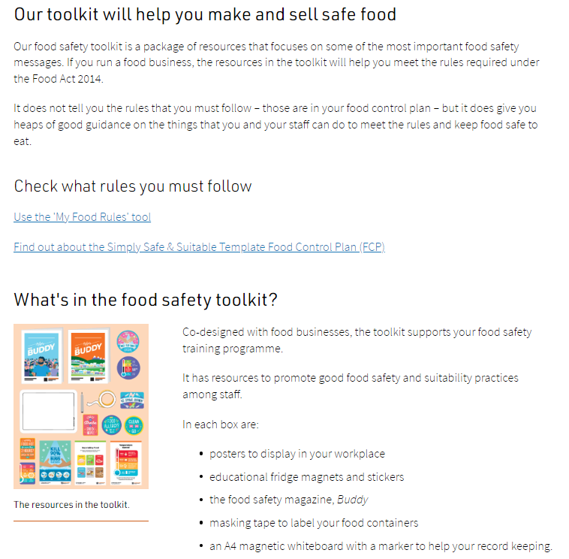
Buddy, top 5 food safety topics, and web page lay out
Buddy 1 guide (originally published in 2018)
Top 5 food service poster (originally published in 2016)
Food Safety Toolkit & Top 5 food safety factors webpages
Notes:
Images provided by Alesha Garton
Buddy and top 5 food safety factors poster are for food service businesses.. These outline the most important things to get right. They are designed to be concise, easy to understand and engaging.
The toolkit web page was revised to make it easier to navigate – added expanding/contracting sections

Slide 11
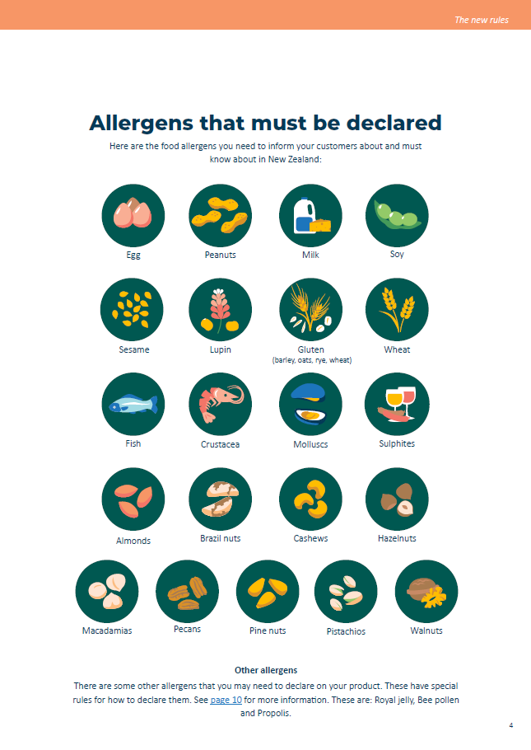
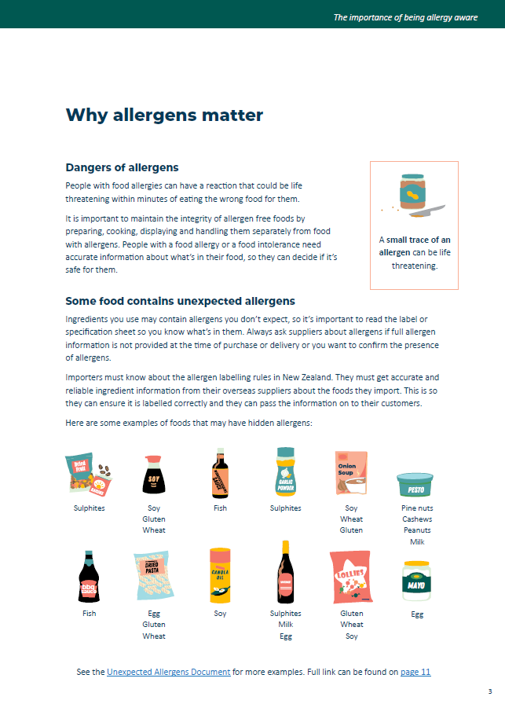
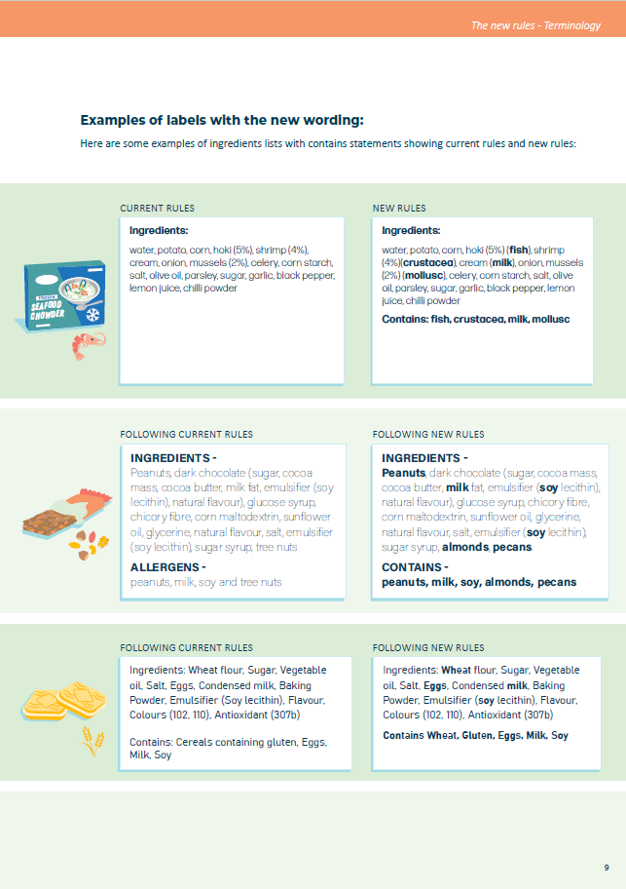
Plain English Allergen Labelling guidance
Notes:
Images provided by Alesha Garton
Next up is PEAL guidance
the Australia New Zealand Food Standards Code (the Code) was amended to introduce new requirements for the labelling of allergens in food. These plain English allergen labelling changes will help people find allergen information on food labels more quickly and easily so they can make informed and safe food choices.
https://www.mpi.govt.nz/dmsdocument/50725-Allergen-labelling-Knowing-whats-in-your-food-and-how-to-label-it

Slide 12
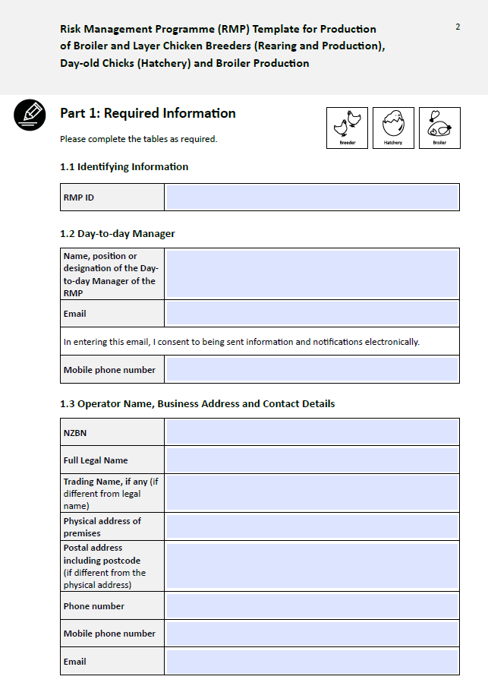
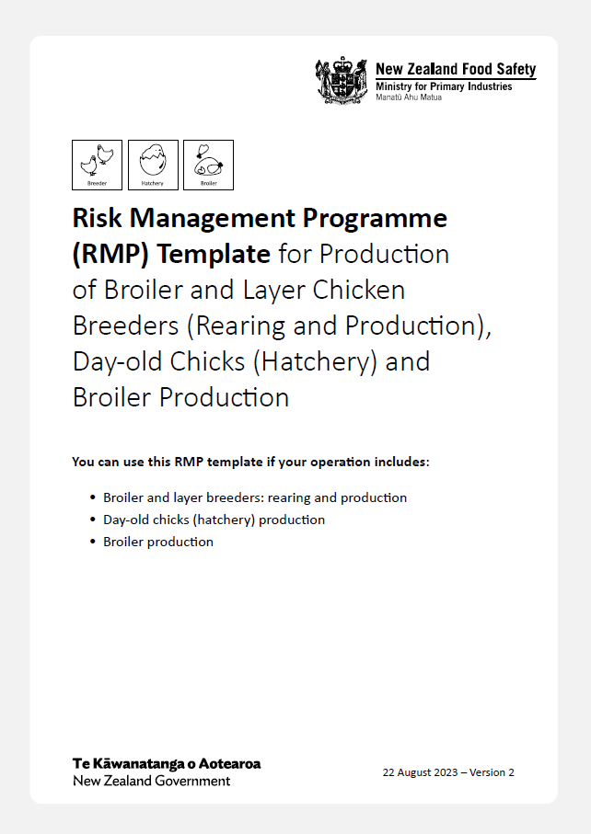
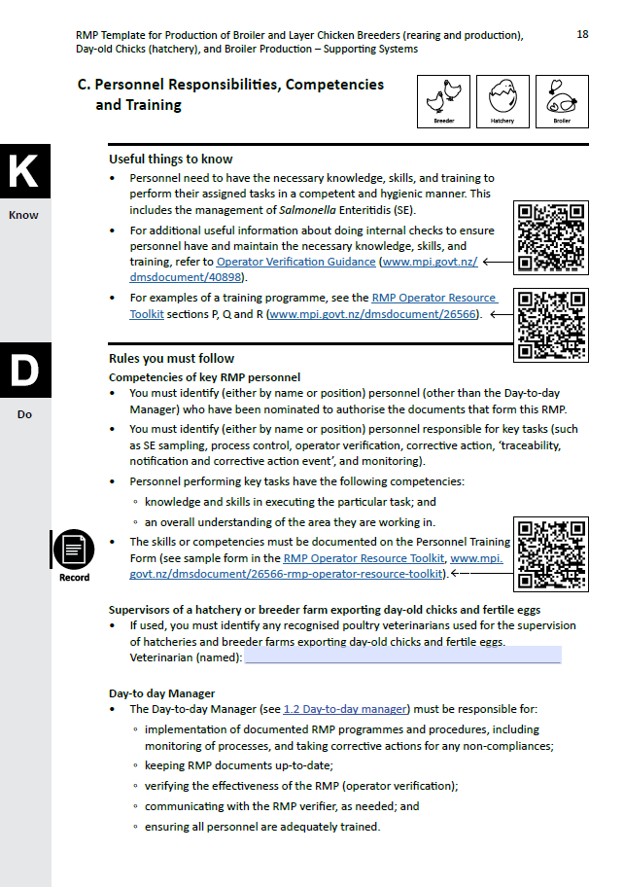
Risk Management Programmes
Notes:
Images provided by Alesha Garton
And finally, the Risk Management Programme templates
Poultry primary processors and some poultry secondary processors must have a registered RMP – similar to SSS in the sense RMPs are written documents that show how you meet your food safety requirements.

Slide 13

What does neurodivergent mean?
“Neurodivergent is a nonmedical term that describes people whose brains develop or work differently for some reason. This means the person has different strengths and struggles from people whose brains develop or work more typically.”
Notes:
Reference
https://my.clevelandclinic.org/health/symptoms/23154-neurodivergent
Image
Stock image

Slide 14
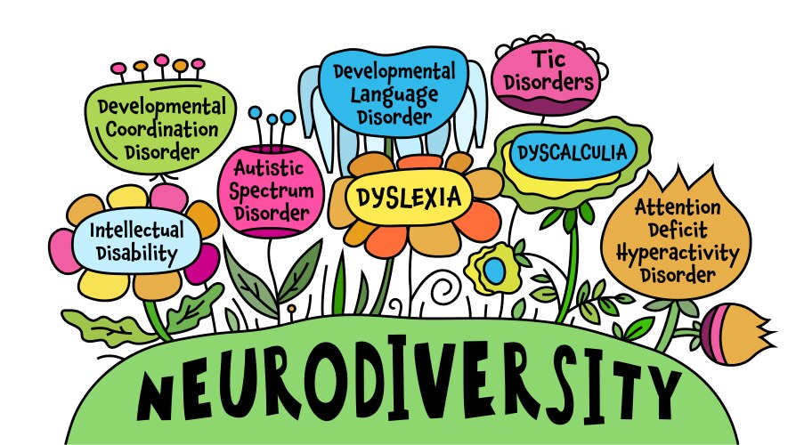
Types of neurodivergent conditions
ADHD
Austism Spectrum Disorder
Dyslexia
Dyscalculia
Dyspraxia
Dysgraphia
Notes:
Reference
https://my.clevelandclinic.org/health/symptoms/23154-neurodivergent
Image
Stock image

Slide 15
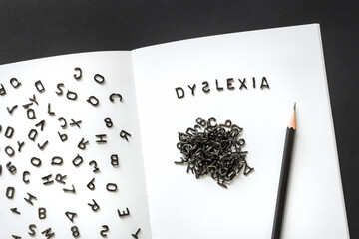
Today I will focus on dyslexia
Notes:
Image source
Stock photo
I covered ADHD and autism last year and plan to cover dyscalculia next week
Today I will focus on dyslexia

Slide 16

Estimated that about 1 in 10 people are dyslexic
That’s about 500,000 people in NZ
Notes:
Reference
https://dfnz.org.nz/wellbeing/

Slide 17
What is dyslexia?
Dyslexia is a neurobiological disorder characterised by difficulties with:
Secondary consequences may include:
Reading
Writing
Spelling
Reduced reading experience which can hinder vocabulary and knowledge
Notes:
References
https://neurodiversity.design/neurotype-definitions/#dyslexia
https://dyslexiaida.org/definition-of-dyslexia/

Slide 18
What is dyslexia?
Confuse similar looking words such as cat and cot
Reverse or transpose similar letters or numbers (for example, b/d; p/q; n/u; 13/31)
Prefer face-to-face meetings/phone calls rather than emails
Prefer charts/graphs over text
Find it hard to scan or skim text
Read/write slowly - Need to re-read paragraphs to understand them
Notes:
References
https://www.bdadyslexia.org.uk/advice/adults/am-i-dyslexic/signs-of-dyslexia
https://dfnz.org.nz/education/
https://my.clevelandclinic.org/health/diseases/6005-dyslexia
https://www.bdadyslexia.org.uk/advice/adults/am-i-dyslexic/signs-of-dyslexia

Slide 19
What is dyslexia?
Find it hard to listen and maintain focus
Find it hard to concentrate if there are distractions
Feel sensations of mental overload/switching off
Have difficulty telling left from right
Get confused when given several instructions at once
Have difficulty organising thoughts on paper
Notes:
References
https://www.bdadyslexia.org.uk/advice/adults/am-i-dyslexic/signs-of-dyslexia
https://dfnz.org.nz/education/
https://my.clevelandclinic.org/health/diseases/6005-dyslexia
https://www.bdadyslexia.org.uk/advice/adults/am-i-dyslexic/signs-of-dyslexia

Slide 20
How can we help people with dyslexia?

Slide 21



Font
Use font that:
Has characters that are distinct from one another
  When certain characters look similar, the brain has to work harder to decipher the text. This can affect reading speed and comprehension.
v
Notes:
Image source
https://business.scope.org.uk/article/font-accessibility-and-readability-the-basics
References
https://business.scope.org.uk/article/font-accessibility-and-readability-the-basics
https://neurodiversity.design/principles/font/
https://numberdyslexia.com/best-and-worst-fonts-for-dyslexia/
https://uxplanet.org/what-to-consider-when-designing-for-dyslexia-b99d373905ac

Slide 22
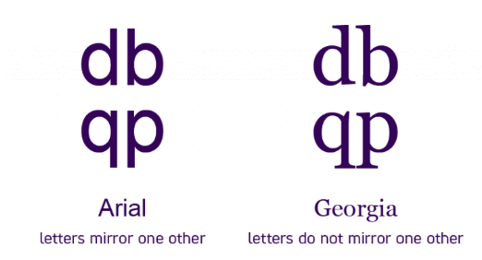
Font
Use font that:
Have letters do not mirror one another
Some characters look the same when you flip them horizontally. For example, “d” and “b” and “p” and “q”.
v
Notes:
Image source
https://business.scope.org.uk/article/font-accessibility-and-readability-the-basics
References
https://business.scope.org.uk/article/font-accessibility-and-readability-the-basics
https://neurodiversity.design/principles/font/
https://numberdyslexia.com/best-and-worst-fonts-for-dyslexia/
https://uxplanet.org/what-to-consider-when-designing-for-dyslexia-b99d373905ac

Slide 23

Font
Use font that is:
Simple and familiar
  Fonts with simple, familiar shapes are generally easier to read.
  This is because most people scan through text quickly when they read. Without needing to read individual letters or words.
  Simple shapes help with reading speed and help reduce cognitive loads.
v
Notes:
References
https://business.scope.org.uk/article/font-accessibility-and-readability-the-basics
https://neurodiversity.design/principles/font/
https://numberdyslexia.com/best-and-worst-fonts-for-dyslexia/
https://uxplanet.org/what-to-consider-when-designing-for-dyslexia-b99d373905ac

Slide 24
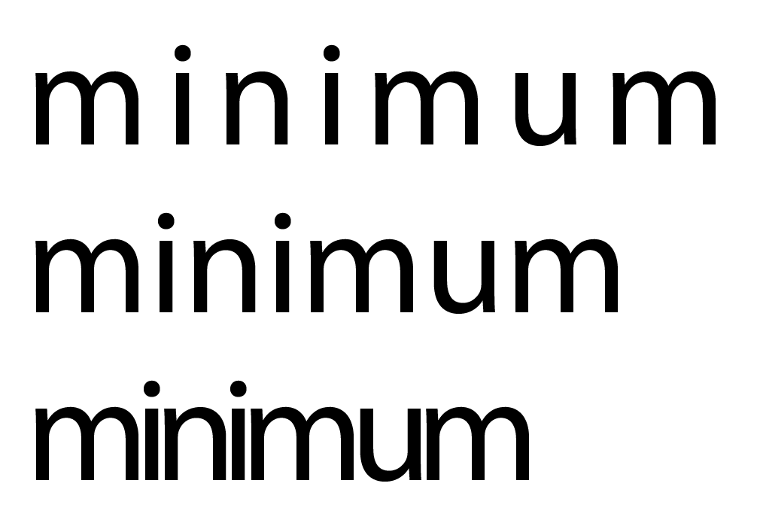
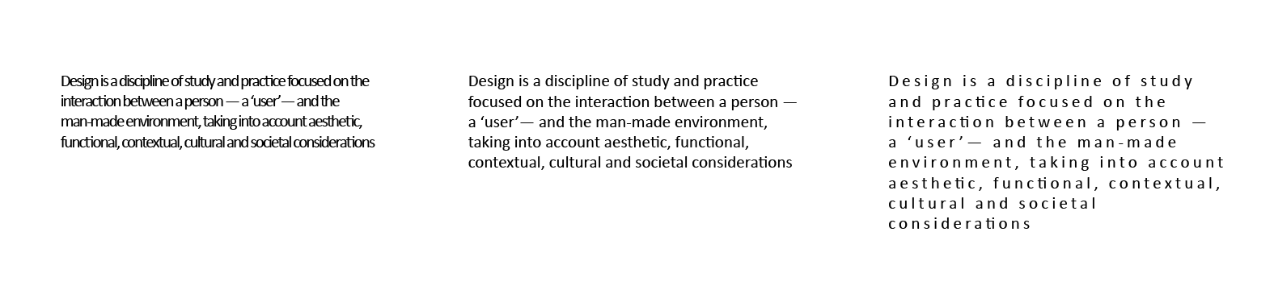
Font
Too much space
Use font that has:
Enough spacing between characters. This makes text easier to read.
Optimal
Too compressed
Too compressed
v
Optimal
Too much space
Notes:
Reference
https://business.scope.org.uk/article/font-accessibility-and-readability-the-basics
https://neurodiversity.design/principles/font/
https://numberdyslexia.com/best-and-worst-fonts-for-dyslexia/
https://uxplanet.org/what-to-consider-when-designing-for-dyslexia-b99d373905ac

Slide 25
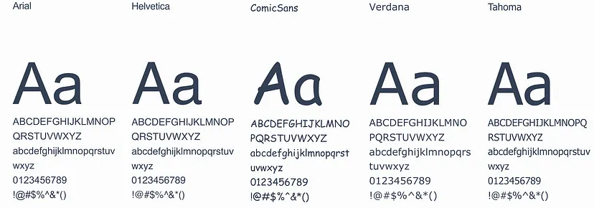
Font
Common fonts that are generally more readable than others (these mostly embody the traits mentioned):
Arial
Tahoma
Helvetica
Calibri
Verdana
Times New Roman
Century Gothic
Comic sans
v
Notes:
References
http://www.bdadyslexia.org.uk/
https://numberdyslexia.com/best-and-worst-fonts-for-dyslexia/
https://business.scope.org.uk/article/font-accessibility-and-readability-the-basics

Slide 26
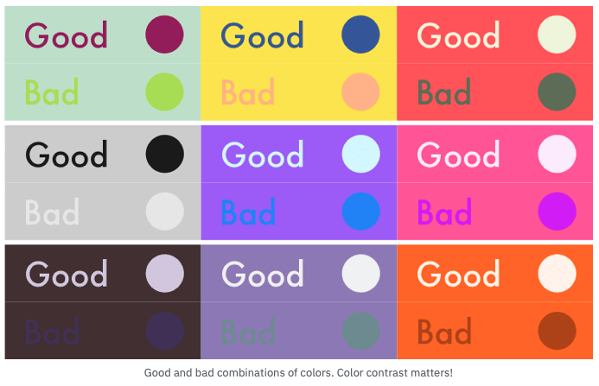
Colour and contrast
Use good contrast between text and background colours. This prevents text and background blending together.
But
Avoid using pure black and pure white. This can make it look like text is moving around. Use dark grey tones instead of pure black and off white instead of pure white.
You can check contrast using tools like this one: https://webaim.org/resources/contrastchecker/
Notes:
Image source
https://neliosoftware.com/blog/which-color-converts-the-best/
References
https://business.scope.org.uk/article/font-accessibility-and-readability-the-basics
https://uxplanet.org/what-to-consider-when-designing-for-dyslexia-b99d373905ac

Slide 27
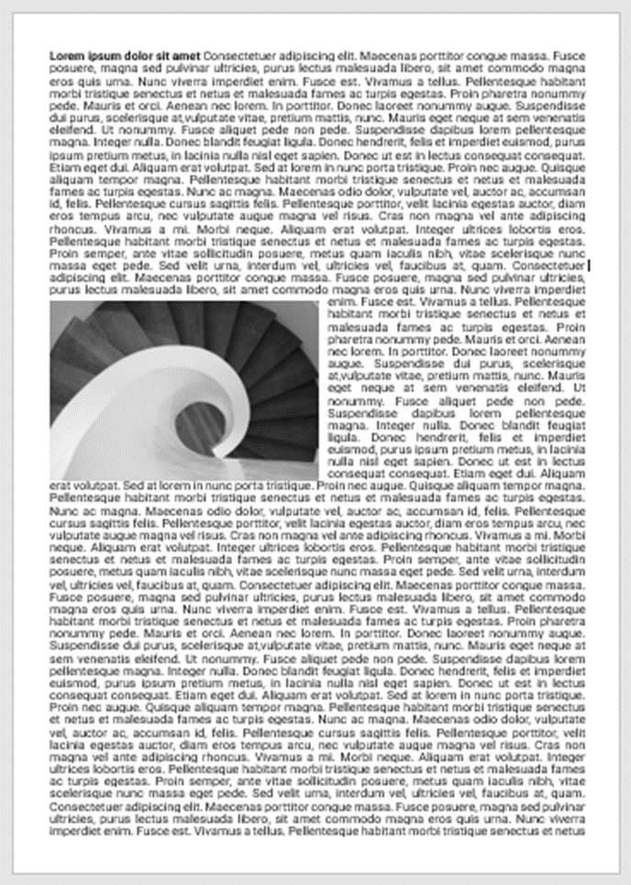
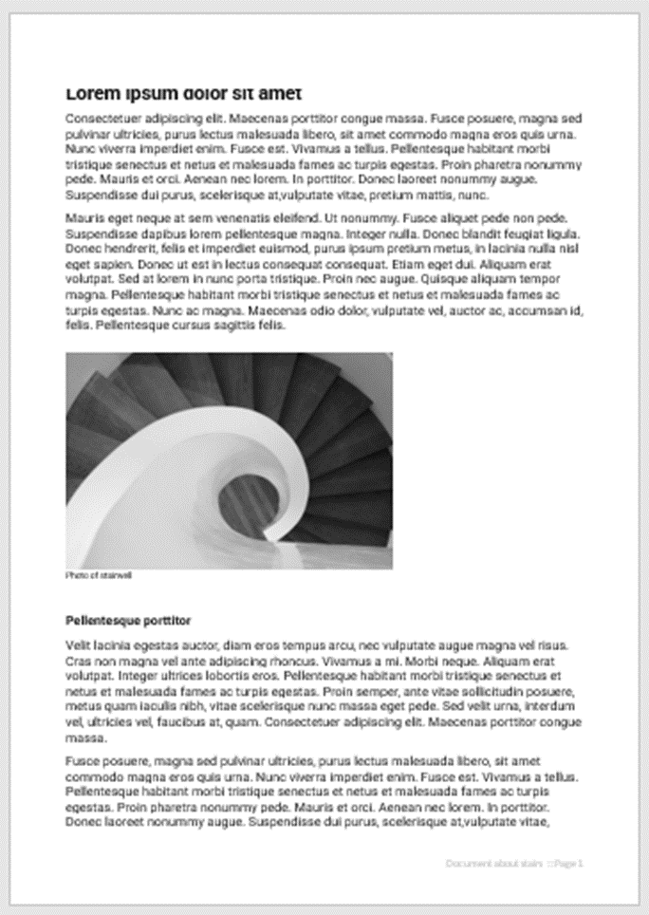
Layout
v
Break up text
Large, walls of text can be overwhelming
Instead, break up text by:
  Use white space
  Increase line spacing to about 1.5
  Use headings
  Use bullet points
Notes:
References
https://uxplanet.org/what-to-consider-when-designing-for-dyslexia-b99d373905ac
https://accessibility.blog.gov.uk/2016/09/02/dos-and-donts-on-designing-for-accessibility/

Slide 28
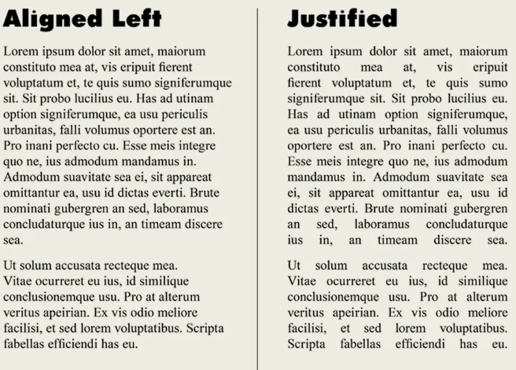
Lay out
v
Avoid Justified text
Justified text can be difficult to read because of the uneven gaps
Use left-aligned text instead
Notes:
Image source:
https://www.shutterstock.com/blog/justify-vs-align-guide-to-type-alignment
References
https://uxplanet.org/what-to-consider-when-designing-for-dyslexia-b99d373905ac
https://accessibility.blog.gov.uk/2016/09/02/dos-and-donts-on-designing-for-accessibility/

Slide 29
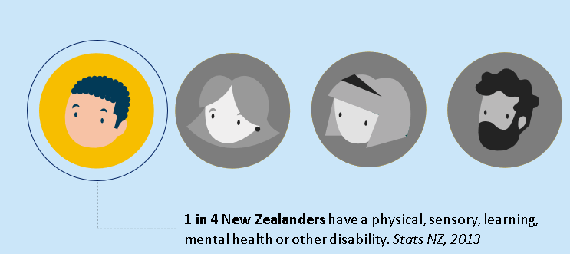
Visuals
Use images, diagrams, flow charts, icons, and graphs to aid understanding
These don’t have to be fancy – Microsoft Office have a suite of icons, images and shapes. You can also use Google too.
Notes:
Image by Alesha Garton
References
https://accessibility.blog.gov.uk/2016/09/02/dos-and-donts-on-designing-for-accessibility/

Slide 30
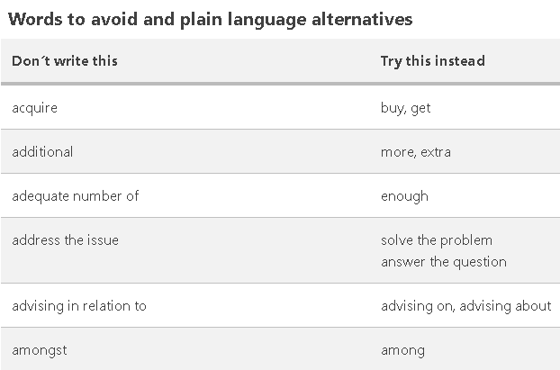
Language
Keep language simple
Simple language helps reduce cognitive load for everyone.
  Use plain everyday language
  Avoid jargon
  Keep special terms to a minimum
Notes:
Image source
https://www.stylemanual.gov.au/writing-and-designing-content/clear-language-and-writing-style/plain-language-and-word-choice
References
https://uxplanet.org/what-to-consider-when-designing-for-dyslexia-b99d373905ac
https://www.stylemanual.gov.au/writing-and-designing-content/clear-language-and-writing-style/plain-language-and-word-choice

Slide 31

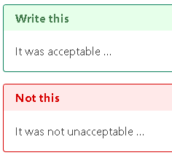
Language
Avoid double negatives
Double negatives are often confusing and lead to misunderstanding
Notes:
Image source
https://www.stylemanual.gov.au/writing-and-designing-content/clear-language-and-writing-style/sentences
References
https://www.bdadyslexia.org.uk/advice/employers/creating-a-dyslexia-friendly-workplace/dyslexia-friendly-style-guide
https://www.stylemanual.gov.au/writing-and-designing-content/clear-language-and-writing-style/sentences

Slide 32
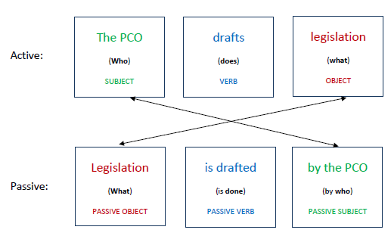
Language
Use active language
An active sentence is structured like this: “who – does - what”
Example: “Most safety belts are retractable”.
Active voice helps readers understand who is doing what
It makes the content less ambiguous, which helps the reader comprehend it quicker
Notes:
Image source
https://www.pco.govt.nz/making-secondary-legislation/plain-language/supporting-documents/6.2
References
https://www.pco.govt.nz/making-secondary-legislation/plain-language/supporting-documents/6.2
https://www.bdadyslexia.org.uk/advice/employers/creating-a-dyslexia-friendly-workplace/dyslexia-friendly-style-guide
https://www.stylemanual.gov.au/writing-and-designing-content/clear-language-and-writing-style/sentences
https://www.svsu.edu/media/writingcenter/Benefits%20of%20Using%20Active%20Voice%20in%20the%20Sciences.pdf

Slide 33
Summary
Dyslexia is a condition that makes reading, writing and spelling difficult
To help people with dyslexia, consider:
  Using familiar, accessible fonts like arial, calibri and times new roman
  Make sure there is a good (not harsh) contrast between text and background
  Use plain language, avoid double negatives and use active language
  Break up text, use visuals, short sentences and avoid justified text

Slide 34
What’s next
12 September 2024 Designing for neurodiversity part 3: Dyscalculia
10 October 2024 Why you should include users/customers in your projects and how to include them
7 November 2024 Sharing user research insights over the years

Slide 35
How did you feel about this talk?
Use react buttons to show how you feel
Do you have any feedback for me? What can be improved? What should we continue?
What else do you want to hear about?
Any guest speakers you want to hear from? Would you like to present on a topic?
Notes:
Use react buttons to show how you feel
Do you have any feedback for me? What can be improved? What should we continue?
What else do you want to hear about?
Any guest speakers you want to hear from?

Slide 36

Thank you for coming along!
Any pātai (questions)? ☺
Notes:
Image by Alesha Garton
Thank you for coming along!
Any pātai (questions)? ☺

Slide 37
Resources
General neurodiversity design guidance
https://www.neurodiversity.design/
Accessibility guidance
https://accessibility.blog.gov.uk/2016/09/02/dos-and-donts-on-designing-for-accessibility/
Language
https://www.stylemanual.gov.au/writing-and-designing-content/clear-language-and-writing-style/
https://hemingwayapp.com/
https://www.pco.govt.nz/making-secondary-legislation/plain-language/supporting-documents/6.2
Notes:
About dyslexia
https://www.bdadyslexia.org.uk/dyslexia/about-dyslexia/what-is-dyslexia
https://dfnz.org.nz/
https://my.clevelandclinic.org/health/diseases/6005-dyslexia
Dyslexia specific design guidance
https://www.bdadyslexia.org.uk/advice/employers/creating-a-dyslexia-friendly-workplace/dyslexia-friendly-style-guide
https://uxplanet.org/what-to-consider-when-designing-for-dyslexia-b99d373905ac
Designing for neurodiversity
https://www.neurodiversity.design/
Accessibility guidance
https://accessibility.blog.gov.uk/2016/09/02/dos-and-donts-on-designing-for-accessibility/
Language
https://www.stylemanual.gov.au/writing-and-designing-content/clear-language-and-writing-style/plain-language-and-word-choice
https://www.stylemanual.gov.au/writing-and-designing-content/clear-language-and-writing-style/sentences
https://hemingwayapp.com/
Colour and contrast
https://www.digital.govt.nz/standards-and-guidance/design-and-ux/accessibility/colour-and-contrast/
https://webaim.org/resources/contrastchecker/
Font
https://business.scope.org.uk/article/font-accessibility-and-readability-the-basics
MPI style guides
https://kotahi.mpi.govt.nz/essentials/guidelines-and-templates/article/1730

Slide 38
Resources
About dyslexia
https://www.bdadyslexia.org.uk/dyslexia/about-dyslexia/what-is-dyslexia
https://dfnz.org.nz/
https://my.clevelandclinic.org/health/diseases/6005-dyslexia
Dyslexia specific design guidance
https://www.bdadyslexia.org.uk/advice/employers/creating-a-dyslexia-friendly-workplace/dyslexia-friendly-style-guide
https://uxplanet.org/what-to-consider-when-designing-for-dyslexia-b99d373905ac
Notes:
About dyslexia
https://www.bdadyslexia.org.uk/dyslexia/about-dyslexia/what-is-dyslexia
https://dfnz.org.nz/
https://my.clevelandclinic.org/health/diseases/6005-dyslexia
Dyslexia specific design guidance
https://www.bdadyslexia.org.uk/advice/employers/creating-a-dyslexia-friendly-workplace/dyslexia-friendly-style-guide
https://uxplanet.org/what-to-consider-when-designing-for-dyslexia-b99d373905ac
Designing for neurodiversity
https://www.neurodiversity.design/
Accessibility guidance
https://accessibility.blog.gov.uk/2016/09/02/dos-and-donts-on-designing-for-accessibility/
Language
https://www.stylemanual.gov.au/writing-and-designing-content/clear-language-and-writing-style/plain-language-and-word-choice
https://www.stylemanual.gov.au/writing-and-designing-content/clear-language-and-writing-style/sentences
https://hemingwayapp.com/
Colour and contrast
https://www.digital.govt.nz/standards-and-guidance/design-and-ux/accessibility/colour-and-contrast/
https://webaim.org/resources/contrastchecker/
Font
https://business.scope.org.uk/article/font-accessibility-and-readability-the-basics
MPI style guides
https://kotahi.mpi.govt.nz/essentials/guidelines-and-templates/article/1730

Slide 39
Resources
Colour and contrast
https://www.digital.govt.nz/standards-and-guidance/design-and-ux/accessibility/colour-and-contrast/
https://webaim.org/resources/contrastchecker/
Font
https://business.scope.org.uk/article/font-accessibility-and-readability-the-basics
MPI style guides
https://kotahi.mpi.govt.nz/essentials/guidelines-and-templates/article/1730
Notes:
About dyslexia
https://www.bdadyslexia.org.uk/dyslexia/about-dyslexia/what-is-dyslexia
https://dfnz.org.nz/
https://my.clevelandclinic.org/health/diseases/6005-dyslexia
Dyslexia specific design guidance
https://www.bdadyslexia.org.uk/advice/employers/creating-a-dyslexia-friendly-workplace/dyslexia-friendly-style-guide
https://uxplanet.org/what-to-consider-when-designing-for-dyslexia-b99d373905ac
Designing for neurodiversity
https://www.neurodiversity.design/
Accessibility guidance
https://accessibility.blog.gov.uk/2016/09/02/dos-and-donts-on-designing-for-accessibility/
Language
https://www.stylemanual.gov.au/writing-and-designing-content/clear-language-and-writing-style/plain-language-and-word-choice
https://www.stylemanual.gov.au/writing-and-designing-content/clear-language-and-writing-style/sentences
https://hemingwayapp.com/
Colour and contrast
https://www.digital.govt.nz/standards-and-guidance/design-and-ux/accessibility/colour-and-contrast/
https://webaim.org/resources/contrastchecker/
Font
https://business.scope.org.uk/article/font-accessibility-and-readability-the-basics
MPI style guides
https://kotahi.mpi.govt.nz/essentials/guidelines-and-templates/article/1730

